Slide 1
MPOPF Simulation and OpenDSS Validation
Aryan Ritwajeet Jha
Graduate Research Assistant
Washington State University
Notes:
Remember to hit the reset button to make sure all the page elements react properly.
There are 20 different layouts that you can choose from.

Slide 2
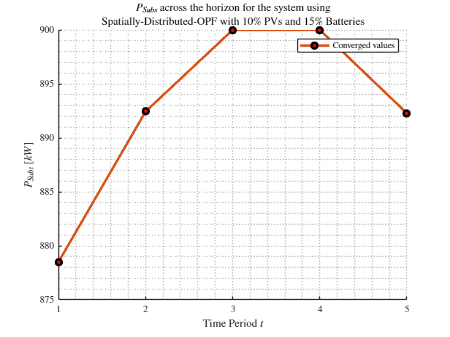
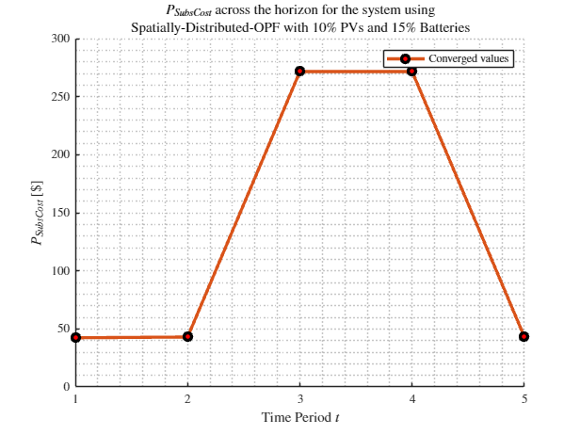
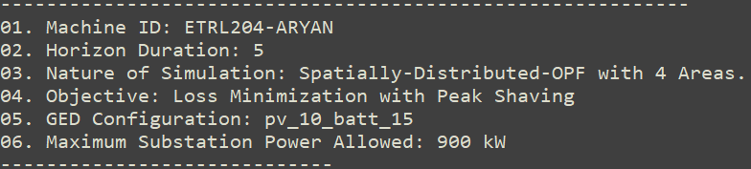
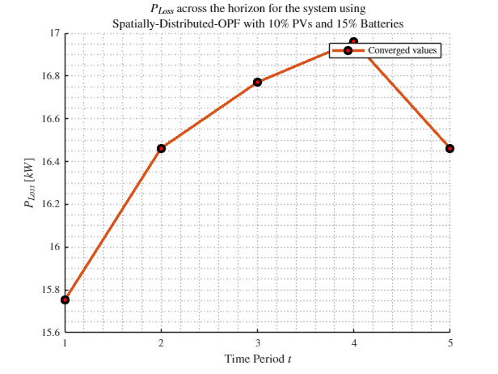
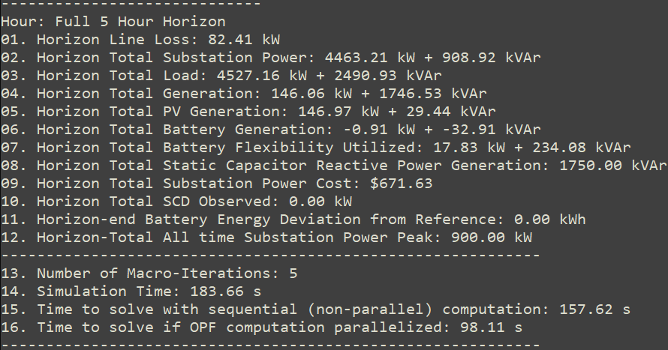
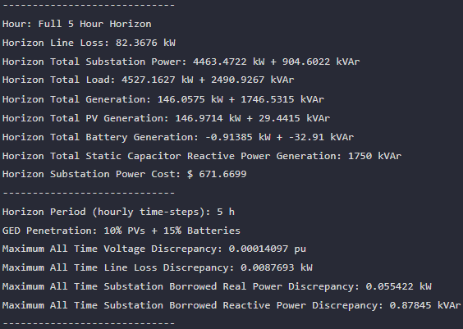

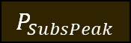



MPDOPF Verified for $T=10, PV=20\%, Batt=30\%$
strLoadShapeCost = 'New Loadshape.LoadShapeCost npts =5 interval = 1 mult = [0.048204 0.048204 0.30181 0.30181 0.048204]'
$P_{Subs}^{t}$
$P_{SubsCost}^{t}$
OpenDSS Def Profiles
Gen Cost
OpenDSS Powerflow Results
$$P_{Loss}^{t}$$
MPDOPF Simulation Results
Objective
$$P_{SubsPeak}$$
Timings
Discrepancies

Slide 3
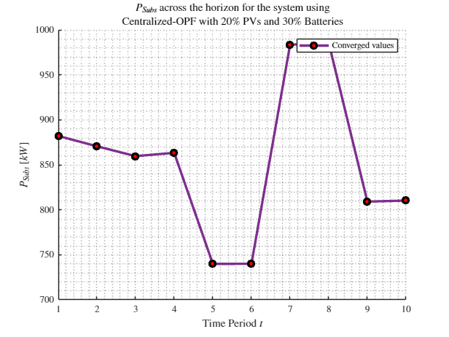
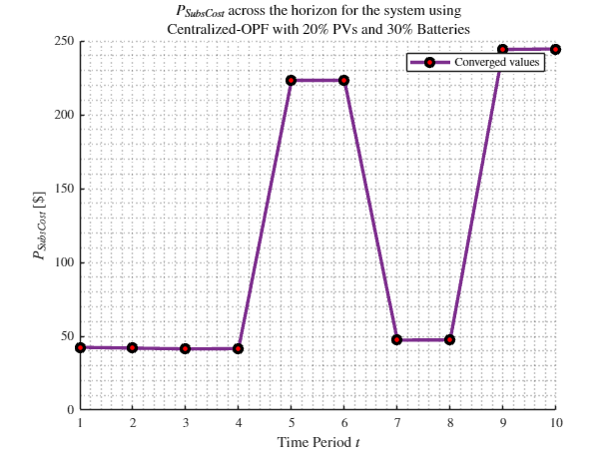
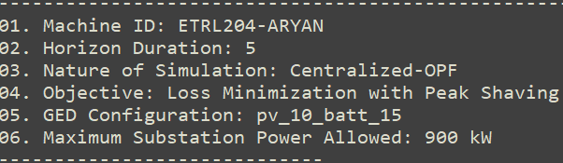
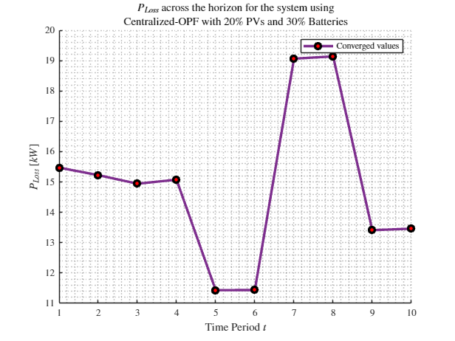
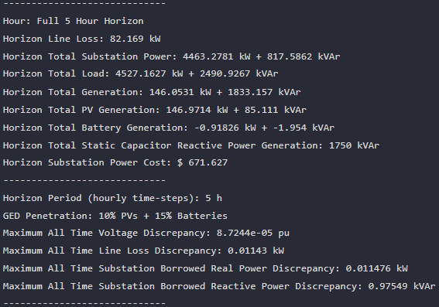


MPCOPF Verified for $T=10, PV=20\%, Batt=30\%$
strLoadShapeCost = 'New Loadshape.LoadShapeCost npts =5 interval = 1 mult = [0.048204 0.048204 0.30181 0.30181 0.048204]'
$P_{Subs}^{t}$
$P_{SubsCost}^{t}$
OpenDSS Def Profiles
Gen Cost
OpenDSS Powerflow Results
$$P_{Loss}^{t}$$
MPDOPF Simulation Results
Objective
$$P_{SubsPeak}$$
Timings
Discrepancies

Slide 4
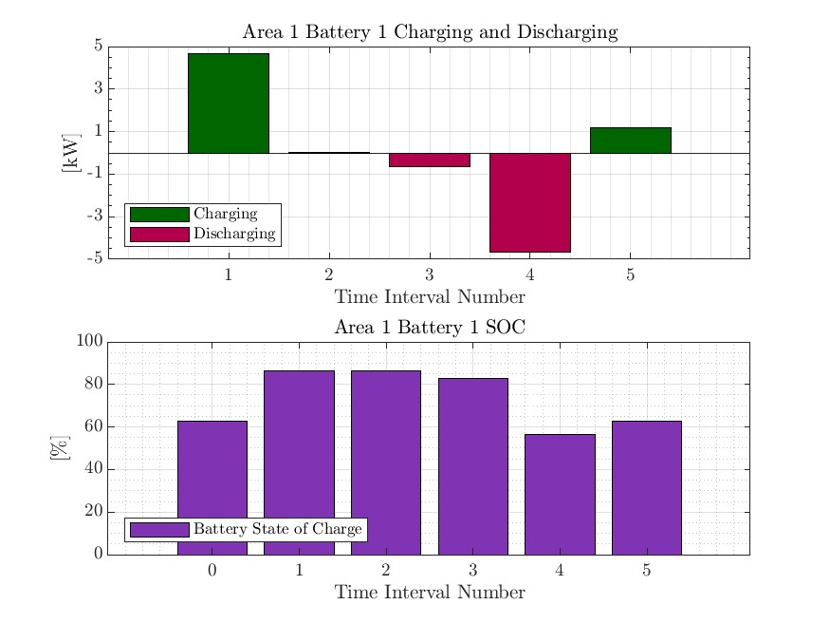
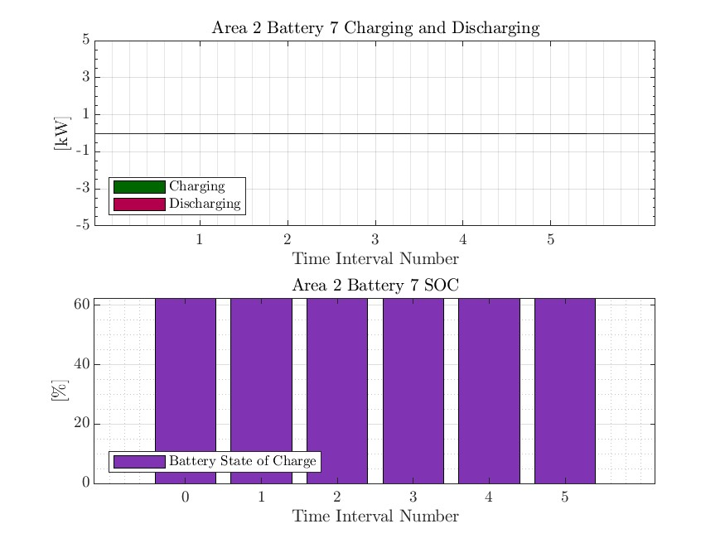



MPDOPF Verified for $T=10, PV=20\%, Batt=30\%$
strLoadShapeCost = 'New Loadshape.LoadShapeCost npts =5 interval = 1 mult = [0.048204 0.048204 0.30181 0.30181 0.048204]'
OpenDSS Def Profiles
Gen Cost

Slide 5

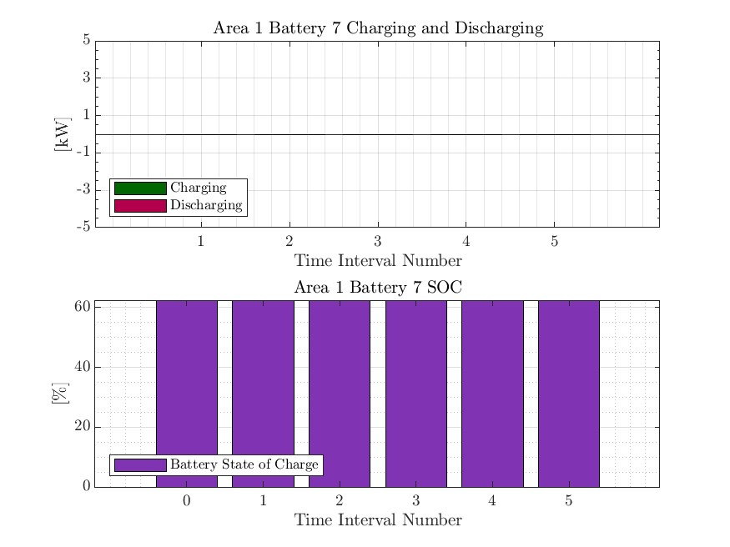
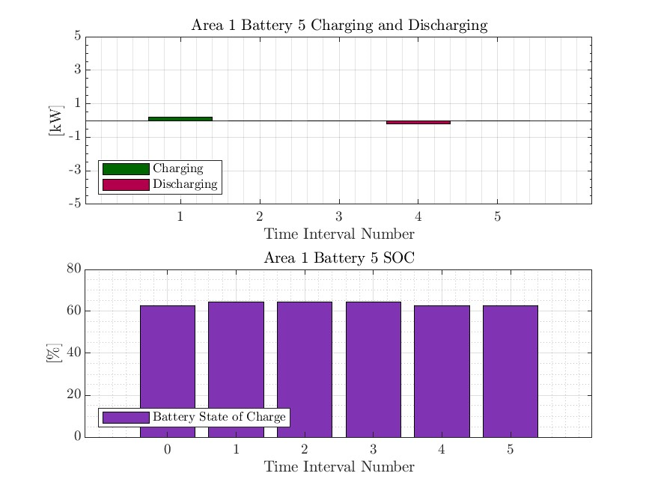


MPCOPF Verified for $T=10, PV=20\%, Batt=30\%$
strLoadShapeCost = 'New Loadshape.LoadShapeCost npts =5 interval = 1 mult = [0.048204 0.048204 0.30181 0.30181 0.048204]'
OpenDSS Def Profiles
Gen Cost

Slide 6

MPDOPF Verified for $T=5, PV=10\%, Batt=15\%$
strLoadShapeCost = 'New Loadshape.LoadShapeCost npts =5 interval = 1 mult = [0.048204 0.048204 0.30181 0.30181 0.048204]'
$P_{Subs}^{t}$
$P_{SubsCost}^{t}$
OpenDSS Def Profiles
Gen Cost + Peak Shave
OpenDSS Powerflow Results
$$P_{Loss}^{t}$$
MPDOPF Simulation Results
Objective
$$P_{SubsPeak}$$
Timings
Discrepancies

Slide 7
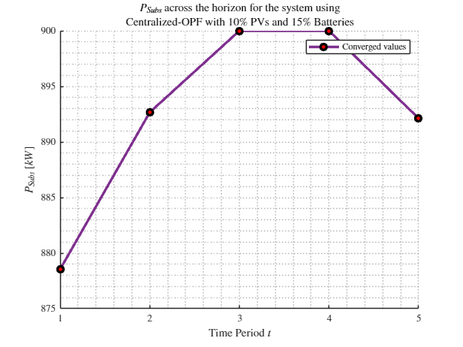
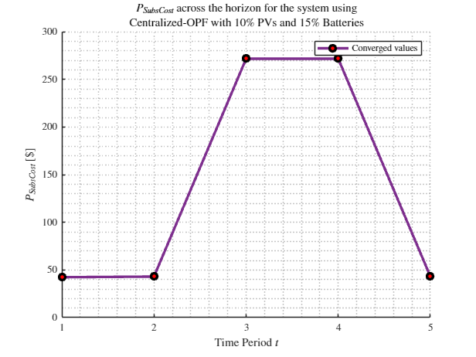
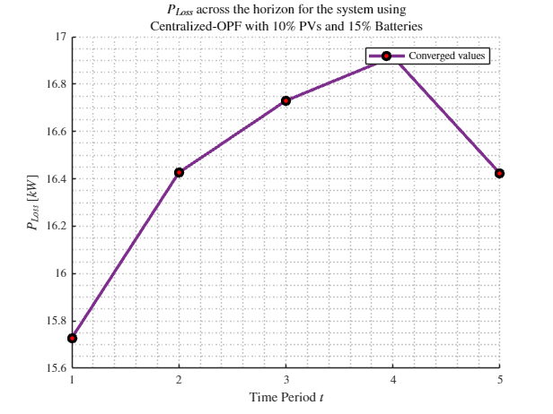

MPCOPF Verified for $T=5, PV=10\%, Batt=15\%$
strLoadShapeCost = 'New Loadshape.LoadShapeCost npts =5 interval = 1 mult = [0.048204 0.048204 0.30181 0.30181 0.048204]'
$P_{Subs}^{t}$
$P_{SubsCost}^{t}$
OpenDSS Def Profiles
Gen Cost + Peak Shave
OpenDSS Powerflow Results
$$P_{Loss}^{t}$$
MPDOPF Simulation Results
Objective
$$P_{SubsPeak}$$
Timings
Discrepancies

Slide 8

MPDOPF Verified for $T=5, PV=10\%, Batt=15\%$
strLoadShapeCost = 'New Loadshape.LoadShapeCost npts =5 interval = 1 mult = [0.048204 0.048204 0.30181 0.30181 0.048204]'
OpenDSS Def Profiles
Gen Cost + Peak Shave

Slide 9

MPCOPF Verified for $T=5, PV=10\%, Batt=15\%$
strLoadShapeCost = 'New Loadshape.LoadShapeCost npts =5 interval = 1 mult = [0.048204 0.048204 0.30181 0.30181 0.048204]'
OpenDSS Def Profiles
Gen Cost + Peak Shave

Slide 10
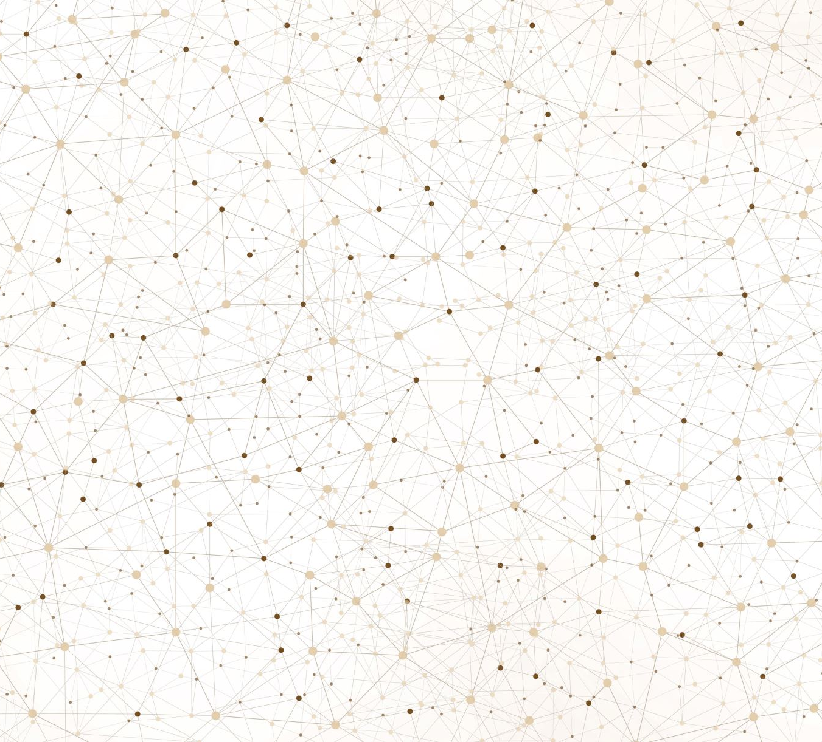
Latest Slides End Here.
Previous Slides Follow

Slide 11
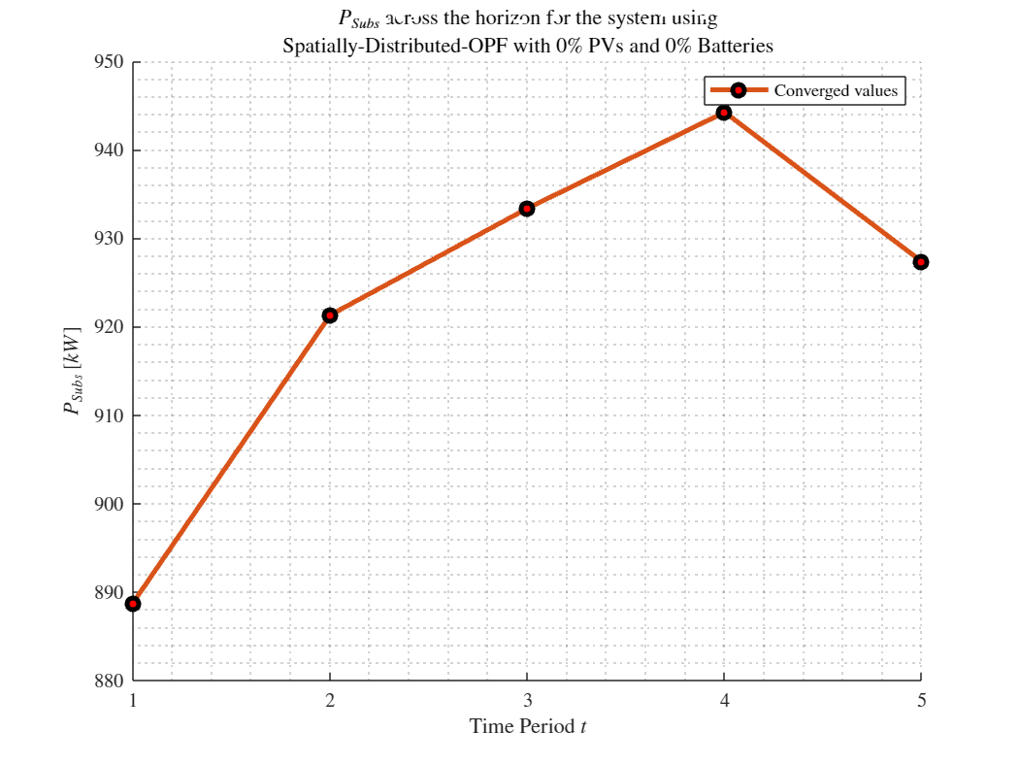
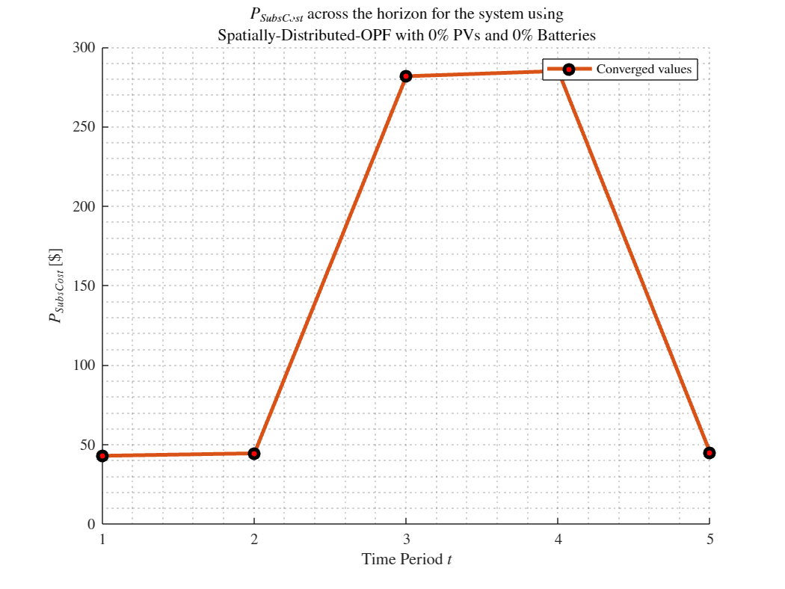
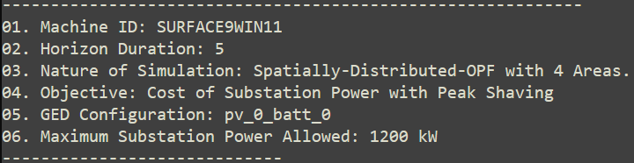
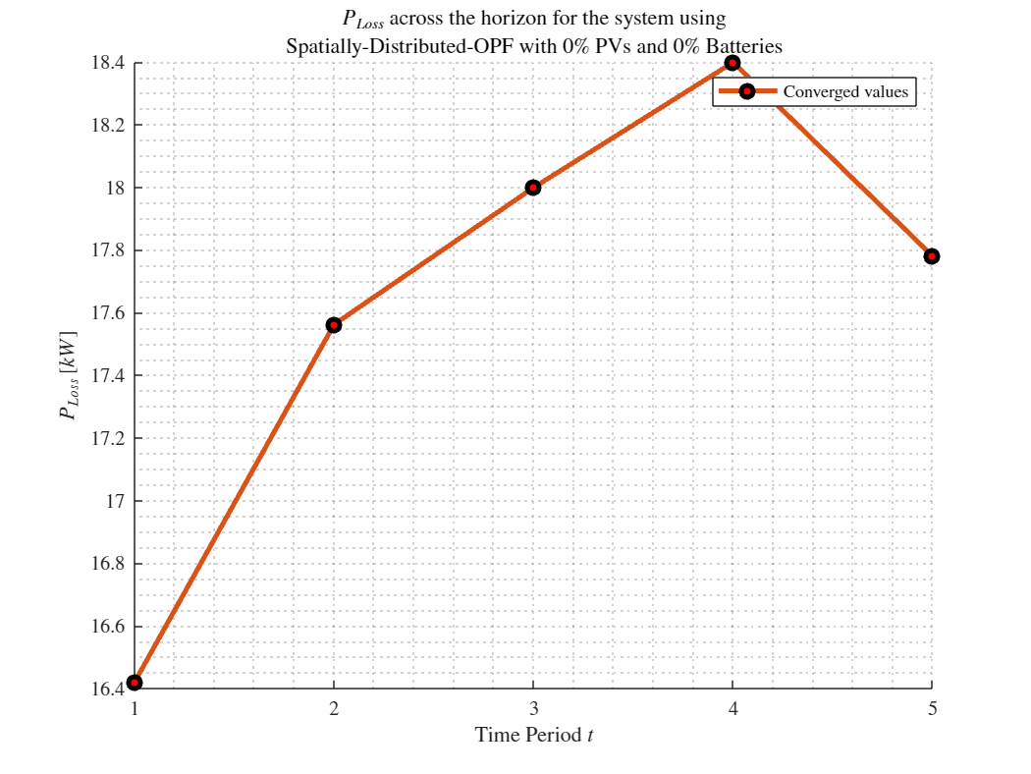
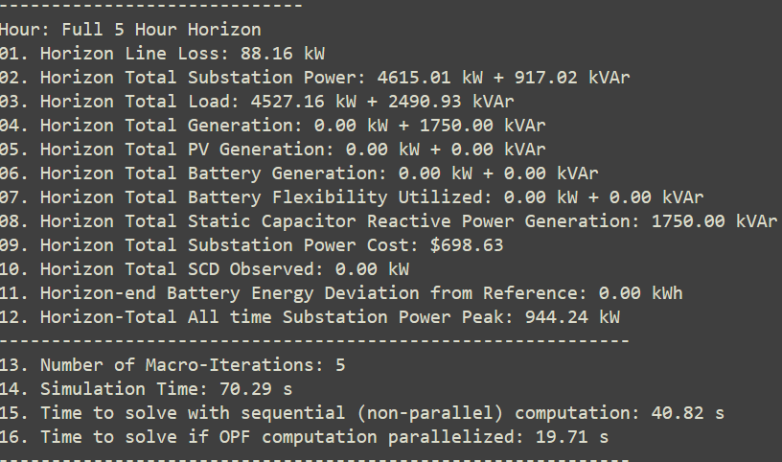
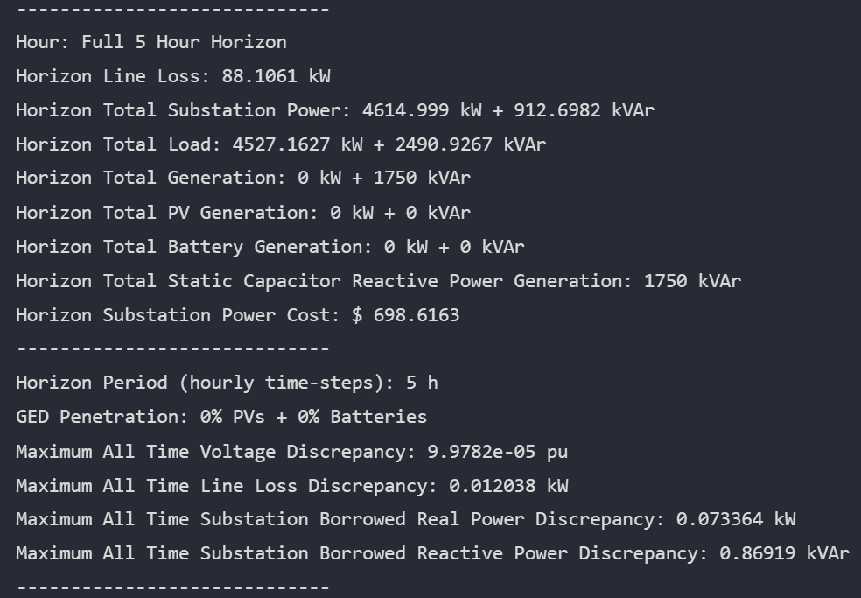

MPDOPF Verified for $T=5, PV=0\%, Batt=0\%$
strLoadShapeCost = 'New Loadshape.LoadShapeCost npts =5 interval = 1 mult = [0.048204 0.048204 0.30181 0.30181 0.048204]'
$P_{Subs}^{t}$
$P_{SubsCost}^{t}$
OpenDSS Def Profiles
Gen Cost+ Peak Shave
OpenDSS Powerflow Results
$$P_{Loss}^{t}$$
MPDOPF Simulation Results
Objective
$$P_{SubsPeak}$$
Timings
Discrepancies

Slide 12
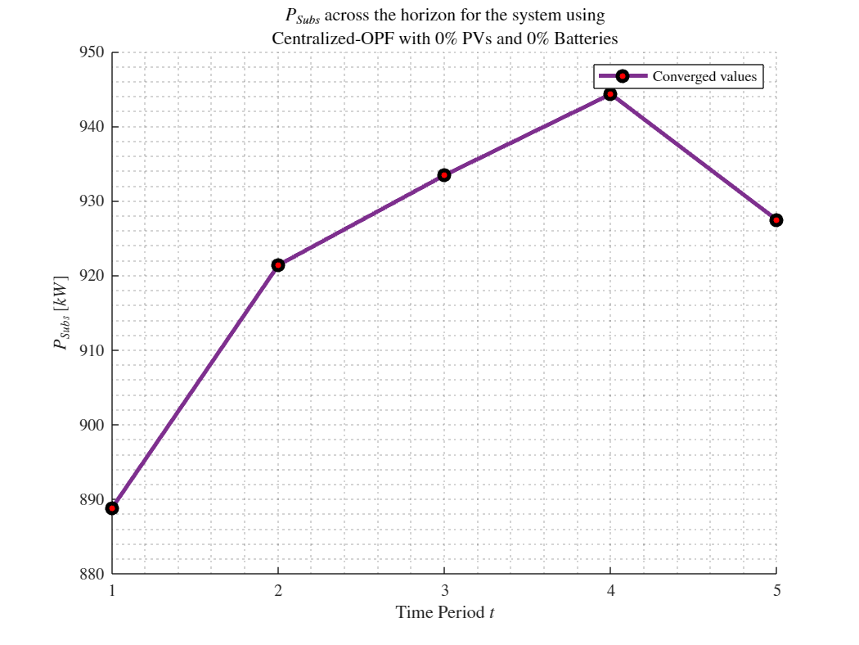
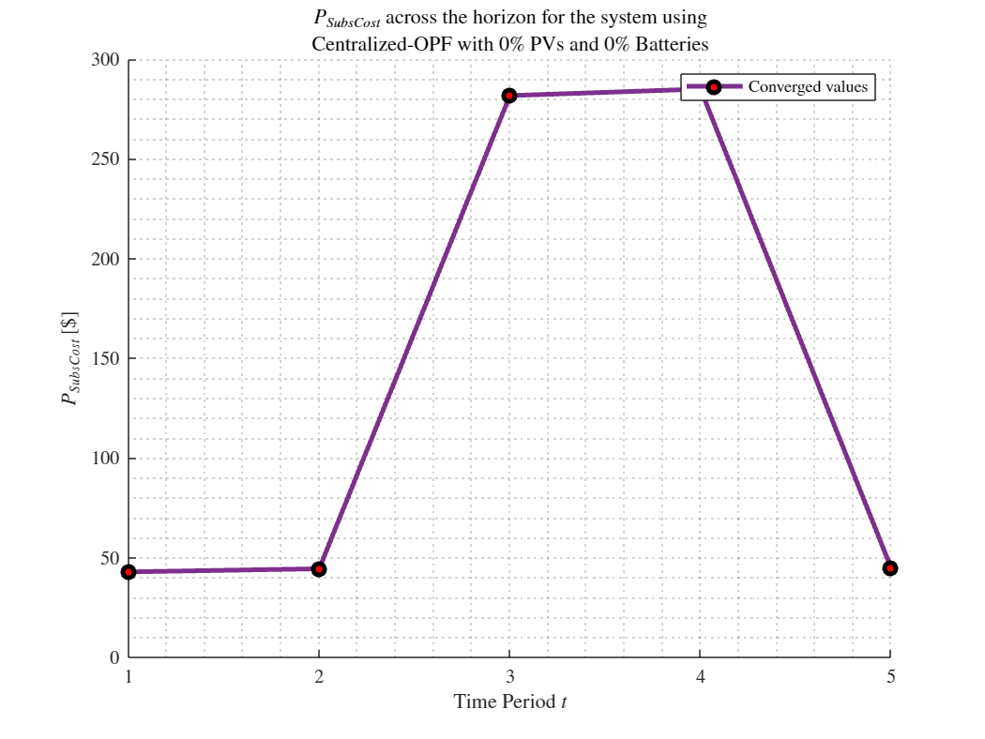
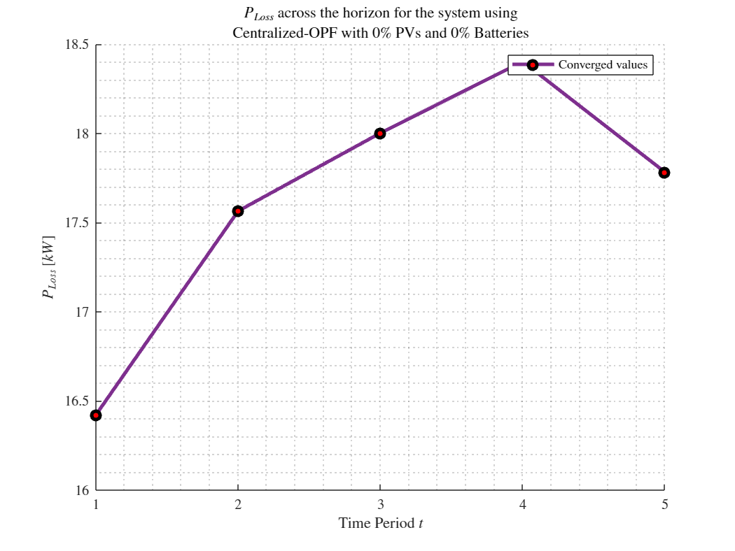
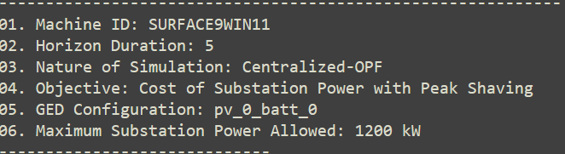
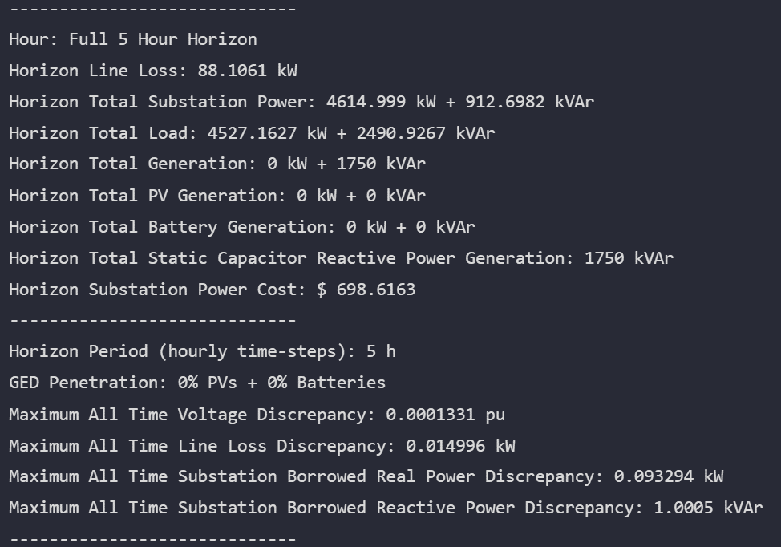
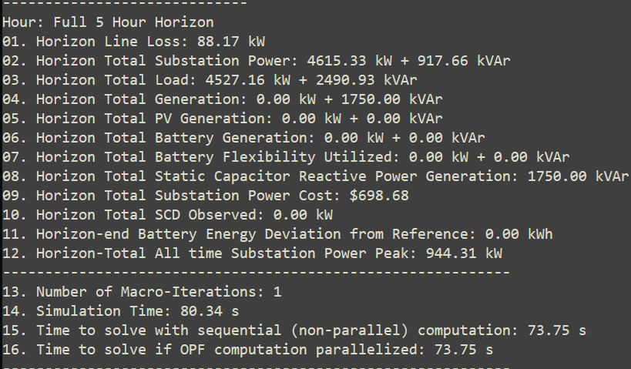

MPCOPF Verified for $T=5, PV=0\%, Batt=0\%$
strLoadShapeCost = 'New Loadshape.LoadShapeCost npts =5 interval = 1 mult = [0.048204 0.048204 0.30181 0.30181 0.048204]'
$P_{Subs}^{t}$
$P_{SubsCost}^{t}$
OpenDSS Def Profiles
Gen Cost + Peak Shave
OpenDSS Powerflow Results
$$P_{Loss}^{t}$$
MPDOPF Simulation Results
Objective
$$P_{SubsPeak}$$
Timings
Discrepancies

Slide 13
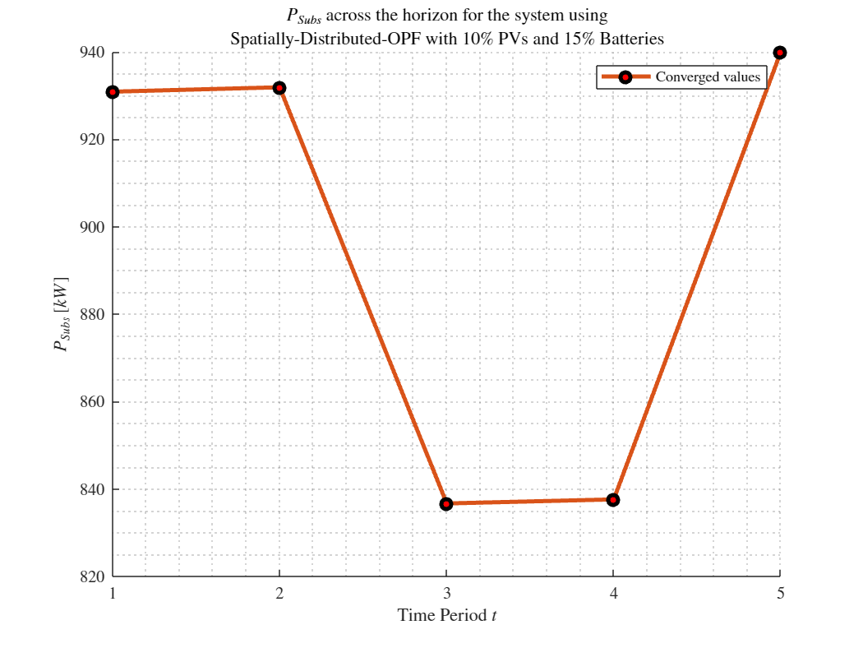
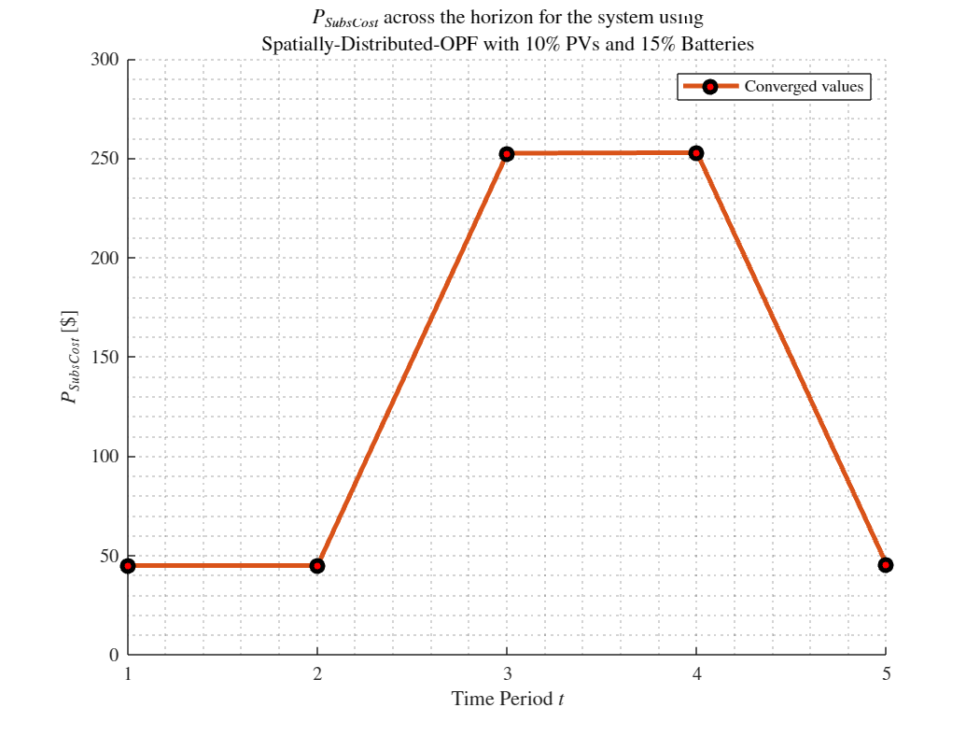
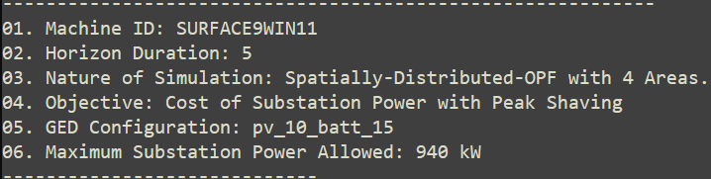
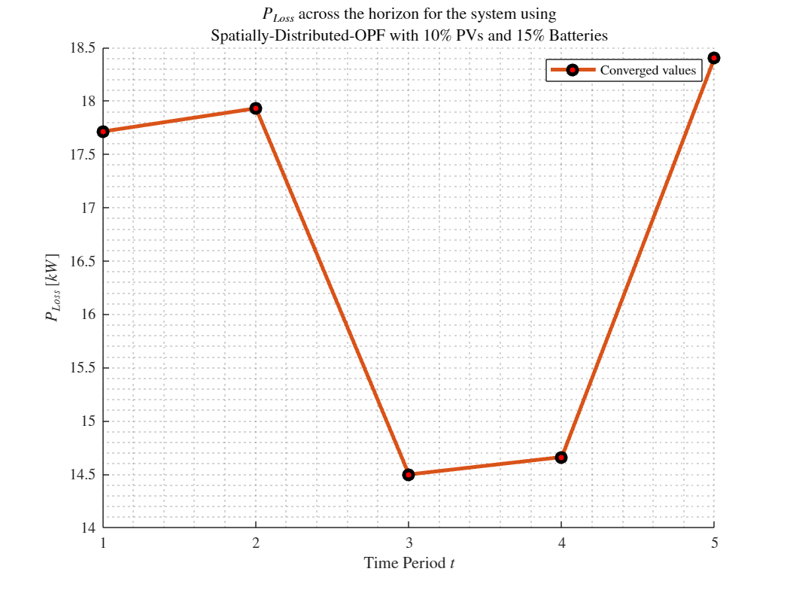
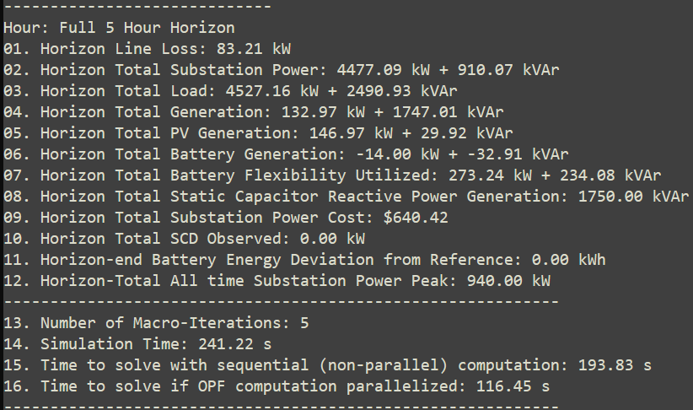
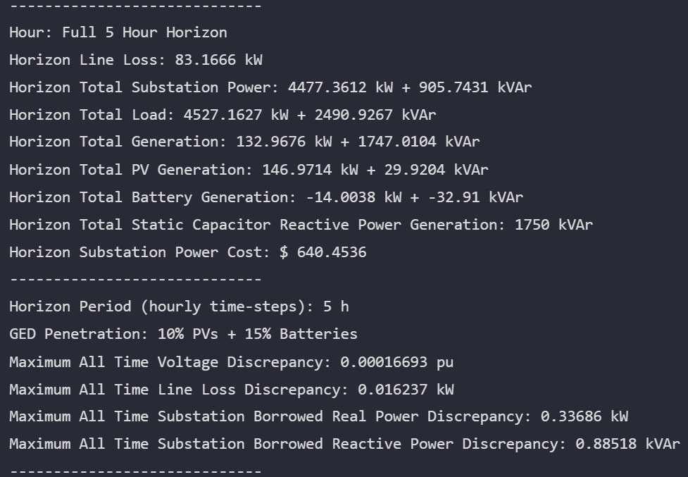
MPDOPF Verified for $T=5, PV=10\%, Batt=15\%$
strLoadShapeCost = 'New Loadshape.LoadShapeCost npts =5 interval = 1 mult = [0.048204 0.048204 0.30181 0.30181 0.048204]'
$P_{Subs}^{t}$
$P_{SubsCost}^{t}$
OpenDSS Def Profiles
Gen Cost + Peak Shave
OpenDSS Powerflow Results
$$P_{Loss}^{t}$$
MPDOPF Simulation Results
Objective
$$P_{SubsPeak}$$
Timings
Discrepancies

Slide 14
MPCOPF Verified for $T=5, PV=10\%, Batt=15\%$
strLoadShapeCost = 'New Loadshape.LoadShapeCost npts =5 interval = 1 mult = [0.048204 0.048204 0.30181 0.30181 0.048204]'
$P_{Subs}^{t}$
$P_{SubsCost}^{t}$
OpenDSS Def Profiles
Gen Cost + Peak Shave
OpenDSS Powerflow Results
$$P_{Loss}^{t}$$
MPDOPF Simulation Results
Objective
$$P_{SubsPeak}$$
Timings
Discrepancies

Slide 15
MPDOPF Verified for $T=5, PV=10\%, Batt=15\%$
strLoadShapeCost = 'New Loadshape.LoadShapeCost npts =5 interval = 1 mult = [0.048204 0.048204 0.30181 0.30181 0.048204]'
OpenDSS Def Profiles
Gen Cost + Peak Shave

Slide 16
MPCOPF Verified for $T=5, PV=10\%, Batt=15\%$
strLoadShapeCost = 'New Loadshape.LoadShapeCost npts =5 interval = 1 mult = [0.048204 0.048204 0.30181 0.30181 0.048204]'
OpenDSS Def Profiles
Gen Cost + Peak Shave

Slide 17
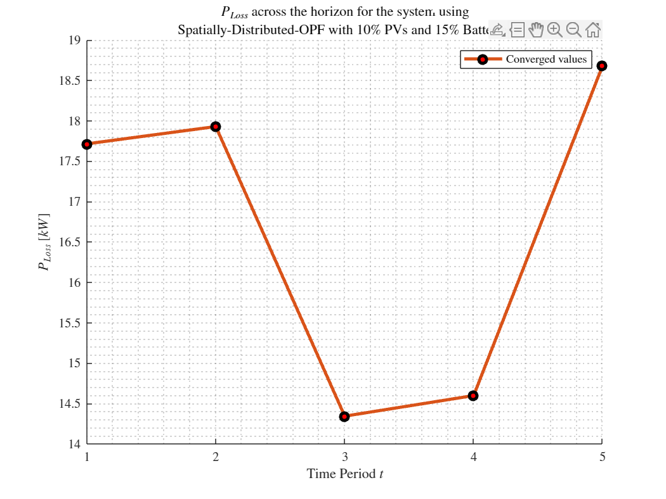

MPDOPF Verified for $T=5, PV=20\%, Batt=30\%$
strLoadShapeCost = 'New Loadshape.LoadShapeCost npts =5 interval = 1 mult = [0.048204 0.048204 0.30181 0.30181 0.048204]'
$P_{Subs}^{t}$
$P_{SubsCost}^{t}$
OpenDSS Def Profiles
Gen Cost + Peak Shave
OpenDSS Powerflow Results
$$P_{Loss}^{t}$$
MPDOPF Simulation Results
Objective
$$P_{SubsPeak}$$
Timings
Discrepancies

Slide 18

MPCOPF Verified for $T=5, PV=20\%, Batt=30\%$
strLoadShapeCost = 'New Loadshape.LoadShapeCost npts =5 interval = 1 mult = [0.048204 0.048204 0.30181 0.30181 0.048204]'
$P_{Subs}^{t}$
$P_{SubsCost}^{t}$
OpenDSS Def Profiles
Gen Cost + Peak Shave
OpenDSS Powerflow Results
$$P_{Loss}^{t}$$
MPDOPF Simulation Results
Objective
$$P_{SubsPeak}$$
Timings
Discrepancies

Slide 19

MPDOPF Verified for $T=5, PV=20\%, Batt=30\%$
strLoadShapeCost = 'New Loadshape.LoadShapeCost npts =5 interval = 1 mult = [0.048204 0.048204 0.30181 0.30181 0.048204]'
OpenDSS Def Profiles
Gen Cost + Peak Shave

Slide 20

MPCOPF Verified for $T=5, PV=20\%, Batt=30\%$
strLoadShapeCost = 'New Loadshape.LoadShapeCost npts =5 interval = 1 mult = [0.048204 0.048204 0.30181 0.30181 0.048204]'
OpenDSS Def Profiles
Gen Cost + Peak Shave

Slide 21

MPDOPF Verified for $T=5, PV=30\%, Batt=45\%$
strLoadShapeCost = 'New Loadshape.LoadShapeCost npts =5 interval = 1 mult = [0.048204 0.048204 0.30181 0.30181 0.048204]'
$P_{Subs}^{t}$
$P_{SubsCost}^{t}$
OpenDSS Def Profiles
Gen Cost + Peak Shave
OpenDSS Powerflow Results
$$P_{Loss}^{t}$$
MPDOPF Simulation Results
Objective
$$P_{SubsPeak}$$
Timings
Discrepancies

Slide 22

MPCOPF Verified for $T=5, PV=30\%, Batt=45\%$
strLoadShapeCost = 'New Loadshape.LoadShapeCost npts =5 interval = 1 mult = [0.048204 0.048204 0.30181 0.30181 0.048204]'
$P_{Subs}^{t}$
$P_{SubsCost}^{t}$
OpenDSS Def Profiles
Gen Cost + Peak Shave
OpenDSS Powerflow Results
$$P_{Loss}^{t}$$
MPDOPF Simulation Results
Objective
$$P_{SubsPeak}$$
Timings
Discrepancies

Slide 23

MPDOPF Verified for $T=5, PV=30\%, Batt=45\%$
strLoadShapeCost = 'New Loadshape.LoadShapeCost npts =5 interval = 1 mult = [0.048204 0.048204 0.30181 0.30181 0.048204]'
OpenDSS Def Profiles
Gen Cost + Peak Shave

Slide 24

MPCOPF Verified for $T=5, PV=30\%, Batt=45\%$
strLoadShapeCost = 'New Loadshape.LoadShapeCost npts =5 interval = 1 mult = [0.048204 0.048204 0.30181 0.30181 0.048204]'
OpenDSS Def Profiles
Gen Cost + Peak Shave

Slide 25
MPDOPF Verified for $T=5, PV=10\%, Batt=15\%$
strLoadShapeCost = 'New Loadshape.LoadShapeCost npts =5 interval = 1 mult = [0.048204 0.048204 0.30181 0.30181 0.048204]'
$P_{Subs}^{t}$
$P_{SubsCost}^{t}$
OpenDSS Def Profiles
Gen Cost + Peak Shave
OpenDSS Powerflow Results
$$P_{Loss}^{t}$$
MPDOPF Simulation Results
Objective
$$P_{SubsPeak}$$
Timings
Discrepancies

Slide 26
MPCOPF Verified for $T=5, PV=10\%, Batt=15\%$
strLoadShapeCost = 'New Loadshape.LoadShapeCost npts =5 interval = 1 mult = [0.048204 0.048204 0.30181 0.30181 0.048204]'
$P_{Subs}^{t}$
$P_{SubsCost}^{t}$
OpenDSS Def Profiles
Gen Cost + Peak Shave
OpenDSS Powerflow Results
$$P_{Loss}^{t}$$
MPDOPF Simulation Results
Objective
$$P_{SubsPeak}$$
Timings
Discrepancies

Slide 27
MPDOPF Verified for $T=5, PV=10\%, Batt=15\%$
strLoadShapeCost = 'New Loadshape.LoadShapeCost npts =5 interval = 1 mult = [0.048204 0.048204 0.30181 0.30181 0.048204]'
OpenDSS Def Profiles
Gen Cost + Peak Shave

Slide 28
MPCOPF Verified for $T=5, PV=10\%, Batt=15\%$
strLoadShapeCost = 'New Loadshape.LoadShapeCost npts =5 interval = 1 mult = [0.048204 0.048204 0.30181 0.30181 0.048204]'
OpenDSS Def Profiles
Gen Cost + Peak Shave

Slide 29
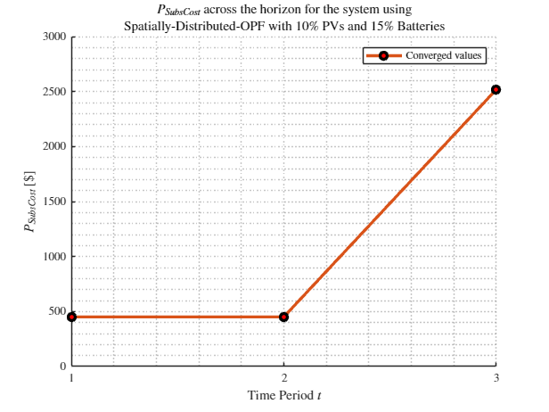
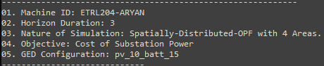
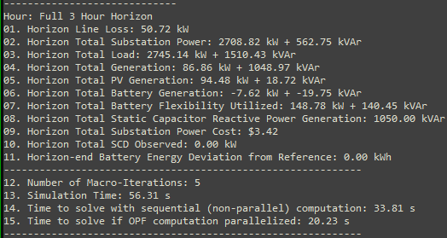
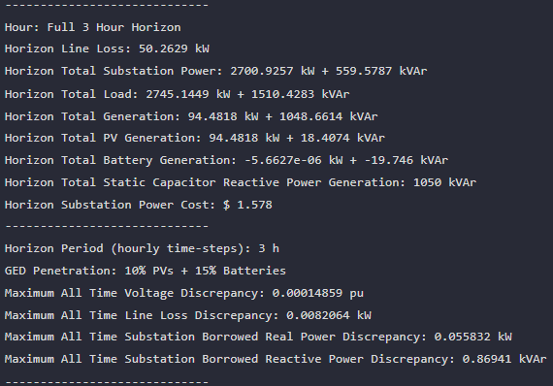

MPDOPF Verified for $T=3, PV=10\%, Batt=15\%$
strLoadShapeCost = 'New Loadshape.LoadShapeCost npts =3 interval = 1 mult = [0.048204 0.048204 0.30181]'
OpenDSS Def Profiles
Gen Cost
MPDOPF Simulation Results
OpenDSS Powerflow Results
Timings
Discrepancies

Slide 30
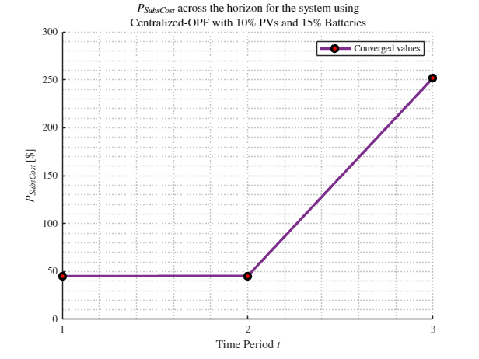
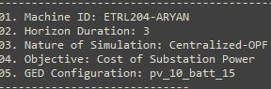
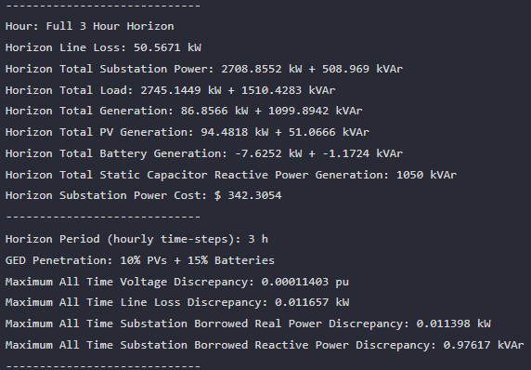
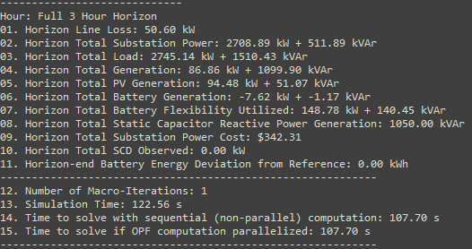

MPCOPF Verified for $T=3, PV=10\%, Batt=15\%$
strLoadShapeCost = 'New Loadshape.LoadShapeCost npts =3 interval = 1 mult = [0.048204 0.048204 0.30181]'
OpenDSS Def Profiles
Gen Cost
MPDOPF Simulation Results
OpenDSS Powerflow Results
Timings
Discrepancies

Slide 31
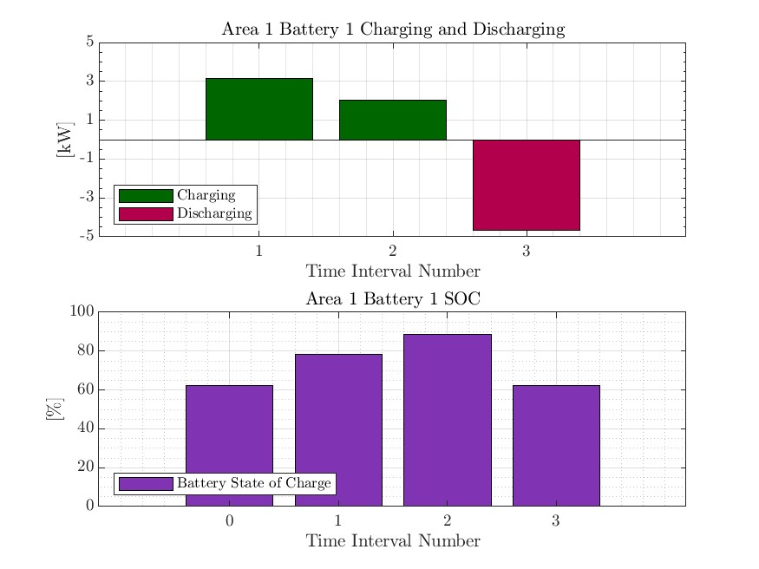
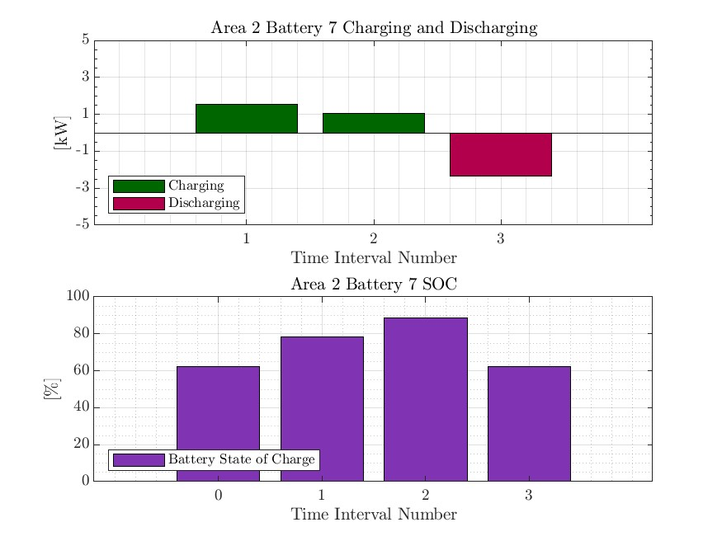
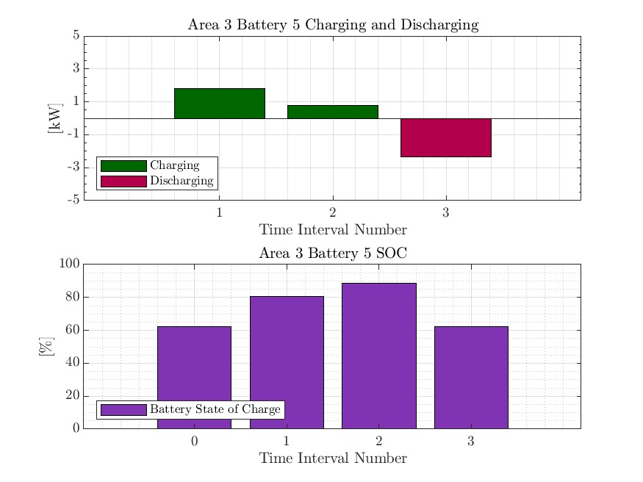


MPDOPF Verified for $T=3, PV=10\%, Batt=15\%$
strLoadShapeCost = 'New Loadshape.LoadShapeCost npts =3 interval = 1 mult = [0.048204 0.048204 0.30181]'
OpenDSS Def Profiles
Gen Cost

Slide 32





MPCOPF Verified for $T=3, PV=10\%, Batt=15\%$
strLoadShapeCost = 'New Loadshape.LoadShapeCost npts =3 interval = 1 mult = [0.048204 0.048204 0.30181]'
OpenDSS Def Profiles
Gen Cost

Slide 33






MPDOPF Verified for $T=3, PV=10\%, Batt=15\%$
strLoadShapeCost = 'New Loadshape.LoadShapeCost npts =3 interval = 1 mult = [0.048204 0.048204 0.30181]'
$P_{Subs}^{t}$
$P_{SubsCost}^{t}$
OpenDSS Def Profiles
Gen Cost + Peak Shave
OpenDSS Powerflow Results
$$P_{Loss}^{t}$$
MPDOPF Simulation Results
Timings
Discrepancies

Slide 34




MPCOPF Verified for $T=3, PV=10\%, Batt=15\%$
strLoadShapeCost = 'New Loadshape.LoadShapeCost npts =3 interval = 1 mult = [0.048204 0.048204 0.30181]'
OpenDSS Def Profiles
Gen Cost + Peak Shave
MPDOPF Simulation Results
OpenDSS Powerflow Results
Timings
Discrepancies

Slide 35
MPDOPF Verified for $T=3, PV=10\%, Batt=15\%$
strLoadShapeCost = 'New Loadshape.LoadShapeCost npts =3 interval = 1 mult = [0.048204 0.048204 0.30181]'
OpenDSS Def Profiles
Gen Cost + Peak Shave

Slide 36




MPCOPF Verified for $T=3, PV=10\%, Batt=15\%$
strLoadShapeCost = 'New Loadshape.LoadShapeCost npts =3 interval = 1 mult = [0.048204 0.048204 0.30181]'
OpenDSS Def Profiles
Gen Cost + Peak Shave

Slide 37






MPDOPF Verified for $T=5, PV=10\%, Batt=15\%$
strLoadShapeCost = 'New Loadshape.LoadShapeCost npts =5 interval = 1 mult = [0.048204 0.048204 0.30181 0.30181 0.048204]'
$P_{Subs}^{t}$
$P_{SubsCost}^{t}$
OpenDSS Def Profiles
Line Losses
OpenDSS Powerflow Results
$$P_{Loss}^{t}$$
MPDOPF Simulation Results
Objective
$$P_{SubsPeak}$$
Timings
Discrepancies

Slide 38






MPCOPF Verified for $T=5, PV=10\%, Batt=15\%$
strLoadShapeCost = 'New Loadshape.LoadShapeCost npts =5 interval = 1 mult = [0.048204 0.048204 0.30181 0.30181 0.048204]'
$P_{Subs}^{t}$
$P_{SubsCost}^{t}$
OpenDSS Def Profiles
Line Losses
OpenDSS Powerflow Results
$$P_{Loss}^{t}$$
MPDOPF Simulation Results
Objective
$$P_{SubsPeak}$$
Discrepancies
Timings

Slide 39

MPDOPF Verified for $T=5, PV=10\%, Batt=15\%$
strLoadShapeCost = 'New Loadshape.LoadShapeCost npts =5 interval = 1 mult = [0.048204 0.048204 0.30181 0.30181 0.048204]'
OpenDSS Def Profiles
Line Losses

Slide 40

MPCOPF Verified for $T=5, PV=10\%, Batt=15\%$
strLoadShapeCost = 'New Loadshape.LoadShapeCost npts =5 interval = 1 mult = [0.048204 0.048204 0.30181 0.30181 0.048204]'
OpenDSS Def Profiles
Line Losses

Slide 41
MPDOPF Verified for $T=5, PV=10\%, Batt=15\%$
strLoadShapeCost = 'New Loadshape.LoadShapeCost npts =5 interval = 1 mult = [0.048204 0.048204 0.30181 0.30181 0.048204]'
$P_{Subs}^{t}$
$P_{SubsCost}^{t}$
OpenDSS Def Profiles
Line Losses + Peak Shave
OpenDSS Powerflow Results
$$P_{Loss}^{t}$$
MPDOPF Simulation Results
Objective
$$P_{SubsPeak}$$
Timings
Discrepancies

Slide 42
MPCOPF Verified for $T=5, PV=10\%, Batt=15\%$
strLoadShapeCost = 'New Loadshape.LoadShapeCost npts =5 interval = 1 mult = [0.048204 0.048204 0.30181 0.30181 0.048204]'
$P_{Subs}^{t}$
$P_{SubsCost}^{t}$
OpenDSS Def Profiles
Line Losses + Peak Shave
OpenDSS Powerflow Results
$$P_{Loss}^{t}$$
MPDOPF Simulation Results
Objective
$$P_{SubsPeak}$$
Timings
Discrepancies

Slide 43
MPDOPF Verified for $T=5, PV=10\%, Batt=15\%$
strLoadShapeCost = 'New Loadshape.LoadShapeCost npts =5 interval = 1 mult = [0.048204 0.048204 0.30181 0.30181 0.048204]'
OpenDSS Def Profiles
Line Losses + Peak Shave

Slide 44
MPCOPF Verified for $T=5, PV=10\%, Batt=15\%$
strLoadShapeCost = 'New Loadshape.LoadShapeCost npts =5 interval = 1 mult = [0.048204 0.048204 0.30181 0.30181 0.048204]'
OpenDSS Def Profiles
Line Losses + Peak Shave

Slide 45






MPDOPF Verified for $T=5, PV=10\%, Batt=15\%$
strLoadShapeCost = 'New Loadshape.LoadShapeCost npts =5 interval = 1 mult = [0.048204 0.048204 0.30181 0.30181 0.048204]'
$P_{Subs}^{t}$
$P_{SubsCost}^{t}$
OpenDSS Def Profiles
Gen Cost
OpenDSS Powerflow Results
$$P_{Loss}^{t}$$
MPDOPF Simulation Results
Objective
$$P_{SubsPeak}$$
Timings
Discrepancies

Slide 46






MPCOPF Verified for $T=5, PV=10\%, Batt=15\%$
strLoadShapeCost = 'New Loadshape.LoadShapeCost npts =5 interval = 1 mult = [0.048204 0.048204 0.30181 0.30181 0.048204]'
$P_{Subs}^{t}$
$P_{SubsCost}^{t}$
OpenDSS Def Profiles
Gen Cost
OpenDSS Powerflow Results
$$P_{Loss}^{t}$$
MPDOPF Simulation Results
Objective
$$P_{SubsPeak}$$
Timings
Discrepancies

Slide 47




MPDOPF Verified for $T=5, PV=10\%, Batt=15\%$
strLoadShapeCost = 'New Loadshape.LoadShapeCost npts =5 interval = 1 mult = [0.048204 0.048204 0.30181 0.30181 0.048204]'
OpenDSS Def Profiles
Gen Cost

Slide 48




MPCOPF Verified for $T=5, PV=10\%, Batt=15\%$
strLoadShapeCost = 'New Loadshape.LoadShapeCost npts =5 interval = 1 mult = [0.048204 0.048204 0.30181 0.30181 0.048204]'
OpenDSS Def Profiles
Gen Cost

Slide 49






MPDOPF Verified for $T=5, PV=10\%, Batt=15\%$
strLoadShapeCost = 'New Loadshape.LoadShapeCost npts =5 interval = 1 mult = [0.048204 0.048204 0.30181 0.30181 0.048204]'
$P_{Subs}^{t}$
$P_{SubsCost}^{t}$
OpenDSS Def Profiles
Gen Cost + Peak Shave
OpenDSS Powerflow Results
$$P_{Loss}^{t}$$
MPDOPF Simulation Results
Timings
Discrepancies

Slide 50






MPCOPF Verified for $T=5, PV=10\%, Batt=15\%$
strLoadShapeCost = 'New Loadshape.LoadShapeCost npts =5 interval = 1 mult = [0.048204 0.048204 0.30181 0.30181 0.048204]'
$P_{Subs}^{t}$
$P_{SubsCost}^{t}$
OpenDSS Def Profiles
Gen Cost + Peak Shave
OpenDSS Powerflow Results
$$P_{Loss}^{t}$$
MPDOPF Simulation Results
Discrepancies
Timings

Slide 51




MPDOPF Verified for $T=5, PV=10\%, Batt=15\%$
strLoadShapeCost = 'New Loadshape.LoadShapeCost npts =5 interval = 1 mult = [0.048204 0.048204 0.30181 0.30181 0.048204]'
OpenDSS Def Profiles
Gen Cost + Peak Shave

Slide 52




MPCOPF Verified for $T=5, PV=10\%, Batt=15\%$
strLoadShapeCost = 'New Loadshape.LoadShapeCost npts =5 interval = 1 mult = [0.048204 0.048204 0.30181 0.30181 0.048204]'
OpenDSS Def Profiles
Gen Cost + Peak Shave

Slide 53







MPDOPF Verified for $T=12, PV=10\%, Batt=15\%$
$P_{Subs}^{t}$
$P_{SubsCost}^{t}$
OpenDSS Def Profiles
Gen Cost + Peak Shave
OpenDSS Powerflow Results
$$P_{Loss}^{t}$$
MPDOPF Simulation Results
Objective
$$P_{SubsPeak}$$
Timings
Discrepancies

Slide 54

MPCOPF Verified for $T=12, PV=10\%, Batt=15\%$
$P_{Subs}^{t}$
$P_{SubsCost}^{t}$
OpenDSS Def Profiles
Gen Cost + Peak Shave
OpenDSS Powerflow Results
$$P_{Loss}^{t}$$
MPDOPF Simulation Results
Timings
Discrepancies

Slide 55





MPDOPF Verified for $T=12, PV=10\%, Batt=15\%$
OpenDSS Def Profiles
Gen Cost + Peak Shave

Slide 56

MPCOPF Verified for $T=12, PV=10\%, Batt=15\%$
OpenDSS Def Profiles
Gen Cost + Peak Shave

Slide 57
MPDOPF Verified for $T=3, PV=10\%, Batt=15\%$
strLoadShape = 'New Loadshape.LoadShape npts =3 interval = 1 mult = [0.777 0.787 0.796]'
strLoadShapePV = 'New Loadshape.LoadShapePV npts =3 interval = 1 mult = [0.8 0.9 1]'
$P_{Subs}^{t}$
$P_{SubsCost}^{t}$
OpenDSS Def Profiles
Gen Cost + Peak Shave
OpenDSS Powerflow Results
$$P_{Loss}^{t}$$
MPDOPF Simulation Results
Timings
Discrepancies

Slide 58
MPCOPF Verified for $T=3, PV=10\%, Batt=15\%$
$P_{Subs}^{t}$
$P_{SubsCost}^{t}$
OpenDSS Def Profiles
Gen Cost + Peak Shave
OpenDSS Powerflow Results
$$P_{Loss}^{t}$$
MPDOPF Simulation Results
Timings
Discrepancies

Slide 59
MPDOPF Verified for $T=3, PV=10\%, Batt=15\%$
OpenDSS Def Profiles
Gen Cost + Peak Shave

Slide 60
MPCOPF Verified for $T=3, PV=10\%, Batt=15\%$
OpenDSS Def Profiles
Gen Cost + Peak Shave

Slide 61





MPDOPF Verified for $T=2, PV=10\%, Batt=15\%$
strLoadShape = 'New Loadshape.LoadShape npts =2 interval = 1 mult = [1 0.7]'
strLoadShapePV = 'New Loadshape.LoadShapePV npts =2 interval = 1 mult = [1.4 0.8]'
MPDOPF Simulation Results
Alternative Profiles
OpenDSS Powerflow Results

Slide 62





MPCOPF Verified for $T=2, PV=10\%, Batt=15\%$
strLoadShape = 'New Loadshape.LoadShape npts =2 interval = 1 mult = [1 0.7]'
strLoadShapePV = 'New Loadshape.LoadShapePV npts =2 interval = 1 mult = [1.4 0.8]'
MPCOPF Simulation Results
Alternative Profiles
OpenDSS Powerflow Results

Slide 63





MPDOPF Verified for $T=2, PV=10\%, Batt=15\%$
strLoadShape = 'New Loadshape.LoadShape npts =2 interval = 1 mult = [1 0.7]'
strLoadShapePV = 'New Loadshape.LoadShapePV npts =2 interval = 1 mult = [1.4 0.8]'
Alternative Profiles

Slide 64




MPCOPF Verified for $T=2, PV=10\%, Batt=15\%$
strLoadShape = 'New Loadshape.LoadShape npts =2 interval = 1 mult = [1 0.7]'
strLoadShapePV = 'New Loadshape.LoadShapePV npts =2 interval = 1 mult = [1.4 0.8]'
Alternative Profiles

Slide 65




Boundary Complex Powers
strLoadShape = 'New Loadshape.LoadShape npts =2 interval = 1 mult = [1 0.7]'
MPDOPF Verified for $T=2, PV=10\%, Batt=15\%$
strLoadShapePV = 'New Loadshape.LoadShapePV npts =2 interval = 1 mult = [1.4 0.8]'
Alternative Profiles

Slide 66



Boundary Voltages
strLoadShape = 'New Loadshape.LoadShape npts =2 interval = 1 mult = [1 0.7]'
MPDOPF Verified for $T=2, PV=10\%, Batt=15\%$
strLoadShapePV = 'New Loadshape.LoadShapePV npts =2 interval = 1 mult = [1.4 0.8]'
Alternative Profiles

Slide 67



MPDOPF Verified for $T=3, PV=10\%, Batt=15\%$
strLoadShape = 'New Loadshape.LoadShape npts =3 interval = 1 mult = [0.777 0.787 0.796]'
strLoadShapePV = 'New Loadshape.LoadShapePV npts =3 interval = 1 mult = [0.8 0.9 1]'
MPDOPF Simulation Results
OpenDSS Powerflow Results
OpenDSS Def Profiles

Slide 68
MPCOPF Verified for $T=3, PV=10\%, Batt=15\%$
strLoadShape = 'New Loadshape.LoadShape npts =3 interval = 1 mult = [0.777 0.787 0.796]'
strLoadShapePV = 'New Loadshape.LoadShapePV npts =3 interval = 1 mult = [0.8 0.9 1]'
MPDOPF Simulation Results
OpenDSS Powerflow Results
OpenDSS Def Profiles

Slide 69



MPDOPF Verified for $T=3, PV=10\%, Batt=15\%$
strLoadShape = 'New Loadshape.LoadShape npts =3 interval = 1 mult = [0.777 0.787 0.796]'
strLoadShapePV = 'New Loadshape.LoadShapePV npts =3 interval = 1 mult = [0.8 0.9 1]'
OpenDSS Def Profiles

Slide 70
MPCOPF Verified for $T=3, PV=10\%, Batt=15\%$
strLoadShape = 'New Loadshape.LoadShape npts =3 interval = 1 mult = [0.777 0.787 0.796]'
strLoadShapePV = 'New Loadshape.LoadShapePV npts =3 interval = 1 mult = [0.8 0.9 1]'
OpenDSS Def Profiles

Slide 71




Boundary Complex Powers
strLoadShape = 'New Loadshape.LoadShape npts =3 interval = 1 mult = [0.777 0.787 0.796]'
MPDOPF Verified for $T=3, PV=10\%, Batt=15\%$
strLoadShapePV = 'New Loadshape.LoadShapePV npts =3 interval = 1 mult = [0.8 0.9 1]'
OpenDSS Def Profiles

Slide 72



Boundary Voltages
strLoadShape = 'New Loadshape.LoadShape npts =3 interval = 1 mult = [0.777 0.787 0.796]'
MPDOPF Verified for $T=3, PV=10\%, Batt=15\%$
strLoadShapePV = 'New Loadshape.LoadShapePV npts =3 interval = 1 mult = [0.8 0.9 1]'
OpenDSS Def Profiles

Slide 73




MPDOPF Verified for $T=3, PV=10\%, Batt=15\%$
strLoadShape = 'New Loadshape.LoadShape npts =3 interval = 1 mult = [0.7 1 0.7]'
strLoadShapePV = 'New Loadshape.LoadShapePV npts =3 interval = 1 mult = [0.8 1 0.8]'
MPDOPF Simulation Results
Alternative Profiles
OpenDSS Powerflow Results

Slide 74




MPCOPF Verified for $T=3, PV=10\%, Batt=15\%$
strLoadShape = 'New Loadshape.LoadShape npts =3 interval = 1 mult = [0.7 1 0.7]'
strLoadShapePV = 'New Loadshape.LoadShapePV npts =3 interval = 1 mult = [0.8 1 0.8]'
MPCOPF Simulation Results
Alternative Profiles
OpenDSS Powerflow Results

Slide 75




MPDOPF Verified for $T=3, PV=10\%, Batt=15\%$
strLoadShape = 'New Loadshape.LoadShape npts =3 interval = 1 mult = [0.7 1 0.7]'
strLoadShapePV = 'New Loadshape.LoadShapePV npts =3 interval = 1 mult = [0.8 1 0.8]'
Alternative Profiles

Slide 76



MPCOPF Verified for $T=3, PV=10\%, Batt=15\%$
strLoadShape = 'New Loadshape.LoadShape npts =3 interval = 1 mult = [0.7 1 0.7]'
strLoadShapePV = 'New Loadshape.LoadShapePV npts =3 interval = 1 mult = [0.8 1 0.8]'
Alternative Profiles

Slide 77



Boundary Complex Powers
strLoadShape = 'New Loadshape.LoadShape npts =3 interval = 1 mult = [0.7 1 0.7]'
MPDOPF Verified for $T=3, PV=10\%, Batt=15\%$
strLoadShapePV = 'New Loadshape.LoadShapePV npts =3 interval = 1 mult = [0.8 1 0.8]'
Alternative Profiles

Slide 78



Boundary Voltages
strLoadShape = 'New Loadshape.LoadShape npts =3 interval = 1 mult = [0.7 1 0.7]'
MPDOPF Verified for $T=3, PV=10\%, Batt=15\%$
strLoadShapePV = 'New Loadshape.LoadShapePV npts =3 interval = 1 mult = [0.8 1 0.8]'
Alternative Profiles

Slide 79




MPDOPF Verified for $T=5, PV=10\%, Batt=15\%$
strLoadShape = 'New Loadshape.LoadShape npts =5 interval = 1 mult = [0.75 0.777 0.787 0.796 0.782]'
strLoadShapePV = 'New Loadshape.LoadShapePV npts =5 interval = 1 mult = [0.5 0.8 0.9 1 1]'
MPDOPF Simulation Results
OpenDSS Powerflow Results

Slide 80




MPCOPF Verified for $T=5, PV=10\%, Batt=15\%$
strLoadShape = 'New Loadshape.LoadShape npts =5 interval = 1 mult = [0.75 0.777 0.787 0.796 0.782]'
strLoadShapePV = 'New Loadshape.LoadShapePV npts =5 interval = 1 mult = [0.5 0.8 0.9 1 1]'
MPCOPF Simulation Results
OpenDSS Powerflow Results

Slide 81




Boundary Complex Powers
MPDOPF Verified for $T=5, PV=10\%, Batt=15\%$

Slide 82



Boundary Voltages
MPDOPF Verified for $T=5, PV=10\%, Batt=15\%$

Slide 83




MPDOPF Verified for $T=5, PV=10\%, Batt=15\%$
strLoadShape = 'New Loadshape.LoadShape npts =5 interval = 1 mult = [0.7 0.85 1 0.85 0.7]'
strLoadShapePV = 'New Loadshape.LoadShapePV npts =5 interval = 1 mult = [1 1.2828 1.4 1.1 0.8]'
MPDOPF Simulation Results
Alternative Profiles
OpenDSS Powerflow Results

Slide 84




MPCOPF Verified for $T=5, PV=10\%, Batt=15\%$
strLoadShape = 'New Loadshape.LoadShape npts =5 interval = 1 mult = [0.7 0.85 1 0.85 0.7]'
strLoadShapePV = 'New Loadshape.LoadShapePV npts =5 interval = 1 mult = [1 1.2828 1.4 1.1 0.8]'
MPCOPF Simulation Results
Alternative Profiles
OpenDSS Powerflow Results

Slide 85




MPDOPF Verified for $T=5, PV=10\%, Batt=15\%$
strLoadShape = 'New Loadshape.LoadShape npts =5 interval = 1 mult = [0.7 0.85 1 0.85 0.7]'
strLoadShapePV = 'New Loadshape.LoadShapePV npts =5 interval = 1 mult = [1 1.2828 1.4 1.1 0.8]'
Alternative Profiles

Slide 86




MPCOPF Verified for $T=5, PV=10\%, Batt=15\%$
strLoadShape = 'New Loadshape.LoadShape npts =5 interval = 1 mult = [0.7 0.85 1 0.85 0.7]'
strLoadShapePV = 'New Loadshape.LoadShapePV npts =5 interval = 1 mult = [1 1.2828 1.4 1.1 0.8]'
Alternative Profiles

Slide 87



Boundary Complex Powers
strLoadShape = 'New Loadshape.LoadShape npts =5 interval = 1 mult = [0.7 0.85 1 0.85 0.7]'
MPDOPF Verified for $T=5, PV=10\%, Batt=15\%$
strLoadShapePV = 'New Loadshape.LoadShapePV npts =5 interval = 1 mult = [1 1.2828 1.4 1.1 0.8]'
Alternative Profiles

Slide 88



Boundary Voltages
strLoadShape = 'New Loadshape.LoadShape npts =5 interval = 1 mult = [0.7 0.85 1 0.85 0.7]'
MPDOPF Verified for $T=5, PV=10\%, Batt=15\%$
strLoadShapePV = 'New Loadshape.LoadShapePV npts =5 interval = 1 mult = [1 1.2828 1.4 1.1 0.8]'
Alternative Profiles

Slide 89


MPDOPF Verified for $T=8, PV=10\%, Batt=15\%$
strLoadShape = 'New Loadshape.LoadShape npts =8 interval = 1 mult = [0.705 0.75 0.777 0.787 0.796 0.782 0.783 0.789]'
strLoadShapePV = 'New Loadshape.LoadShapePV npts =8 interval = 1 mult = [0.3 0.5 0.8 0.9 1 1 0.99 0.9]'
MPDOPF Simulation Results
OpenDSS Powerflow Results

Slide 90





MPCOPF Verified for $T=8, PV=10\%, Batt=15\%$
strLoadShape = 'New Loadshape.LoadShape npts =8 interval = 1 mult = [0.705 0.75 0.777 0.787 0.796 0.782 0.783 0.789]'
strLoadShapePV = 'New Loadshape.LoadShapePV npts =8 interval = 1 mult = [0.3 0.5 0.8 0.9 1 1 0.99 0.9]'
MPCOPF Simulation Results
OpenDSS Powerflow Results

Slide 91

MPDOPF Verified for $T=8, PV=10\%, Batt=15\%$
strLoadShape = 'New Loadshape.LoadShape npts =8 interval = 1 mult = [0.705 0.75 0.777 0.787 0.796 0.782 0.783 0.789]'
1, 5, 7, 8 in COPF values
strLoadShapePV = 'New Loadshape.LoadShapePV npts =8 interval = 1 mult = [0.3 0.5 0.8 0.9 1 1 0.99 0.9]'

Slide 92





MPCOPF Verified for $T=8, PV=10\%, Batt=15\%$
strLoadShape = 'New Loadshape.LoadShape npts =8 interval = 1 mult = [0.705 0.75 0.777 0.787 0.796 0.782 0.783 0.789]'
strLoadShapePV = 'New Loadshape.LoadShapePV npts =8 interval = 1 mult = [0.3 0.5 0.8 0.9 1 1 0.99 0.9]'

Slide 93




Boundary Complex Powers
strLoadShape = 'New Loadshape.LoadShape npts =8 interval = 1 mult = [0.705 0.75 0.777 0.787 0.796 0.782 0.783 0.789]'
MPDOPF Verified for $T=8, PV=10\%, Batt=15\%$
strLoadShapePV = 'New Loadshape.LoadShapePV npts =8 interval = 1 mult = [0.3 0.5 0.8 0.9 1 1 0.99 0.9]'

Slide 94



Boundary Voltages
strLoadShape = 'New Loadshape.LoadShape npts =8 interval = 1 mult = [0.705 0.75 0.777 0.787 0.796 0.782 0.783 0.789]'
MPDOPF Verified for $T=8, PV=10\%, Batt=15\%$
strLoadShapePV = 'New Loadshape.LoadShapePV npts =8 interval = 1 mult = [0.3 0.5 0.8 0.9 1 1 0.99 0.9]'

Slide 95





MPDOPF Verified for $T=9, PV=10\%, Batt=15\%$
strLoadShape = 'New Loadshape.LoadShape npts =9 interval = 1 mult = [0.668 0.705 0.75 0.777 0.787 0.796 0.782 0.783 0.789]'
strLoadShapePV = 'New Loadshape.LoadShapePV npts =9 interval = 1 mult = [0.2 0.3 0.5 0.8 0.9 1 1 0.99 0.9]'
MPDOPF Simulation Results
OpenDSS Powerflow Results

Slide 96





MPCOPF Verified for $T=9, PV=10\%, Batt=15\%$
strLoadShape = 'New Loadshape.LoadShape npts =9 interval = 1 mult = [0.668 0.705 0.75 0.777 0.787 0.796 0.782 0.783 0.789]'
strLoadShapePV = 'New Loadshape.LoadShapePV npts =9 interval = 1 mult = [0.2 0.3 0.5 0.8 0.9 1 1 0.99 0.9]'
MPCOPF Simulation Results
OpenDSS Powerflow Results

Slide 97








MPDOPF Verified for $T=9, PV=10\%, Batt=15\%$
strLoadShape = 'New Loadshape.LoadShape npts =9 interval = 1 mult = [0.668 0.705 0.75 0.777 0.787 0.796 0.782 0.783 0.789]'
strLoadShapePV = 'New Loadshape.LoadShapePV npts =9 interval = 1 mult = [0.2 0.3 0.5 0.8 0.9 1 1 0.99 0.9]'

Slide 98








MPCOPF Verified for $T=9, PV=10\%, Batt=15\%$
strLoadShape = 'New Loadshape.LoadShape npts =9 interval = 1 mult = [0.668 0.705 0.75 0.777 0.787 0.796 0.782 0.783 0.789]'
strLoadShapePV = 'New Loadshape.LoadShapePV npts =9 interval = 1 mult = [0.2 0.3 0.5 0.8 0.9 1 1 0.99 0.9]'

Slide 99




Boundary Complex Powers
strLoadShape = 'New Loadshape.LoadShape npts =9 interval = 1 mult = [0.668 0.705 0.75 0.777 0.787 0.796 0.782 0.783 0.789]'
MPDOPF Verified for $T=9, PV=10\%, Batt=15\%$
strLoadShapePV = 'New Loadshape.LoadShapePV npts =9 interval = 1 mult = [0.2 0.3 0.5 0.8 0.9 1 1 0.99 0.9]'

Slide 100



Boundary Voltages
strLoadShape = 'New Loadshape.LoadShape npts =9 interval = 1 mult = [0.668 0.705 0.75 0.777 0.787 0.796 0.782 0.783 0.789]'
MPDOPF Verified for $T=9, PV=10\%, Batt=15\%$
strLoadShapePV = 'New Loadshape.LoadShapePV npts =9 interval = 1 mult = [0.2 0.3 0.5 0.8 0.9 1 1 0.99 0.9]'

Slide 101





MPDOPF Verified for $T=10, PV=10\%, Batt=15\%$
strLoadShape = 'New Loadshape.LoadShape npts =10 interval = 1 mult = [0.668 0.705 0.75 0.777 0.787 0.796 0.782 0.783 0.789 0.826]'
strLoadShapePV = 'New Loadshape.LoadShapePV npts =10 interval = 1 mult = [0.2 0.3 0.5 0.8 0.9 1 1 0.99 0.9 0.7]'
MPDOPF Simulation Results
OpenDSS Powerflow Results

Slide 102





MPCOPF Verified for $T=10, PV=10\%, Batt=15\%$
strLoadShape = 'New Loadshape.LoadShape npts =10 interval = 1 mult = [0.668 0.705 0.75 0.777 0.787 0.796 0.782 0.783 0.789 0.826]'
strLoadShapePV = 'New Loadshape.LoadShapePV npts =10 interval = 1 mult = [0.2 0.3 0.5 0.8 0.9 1 1 0.99 0.9 0.7]'
MPCOPF Simulation Results
OpenDSS Powerflow Results

Slide 103





MPDOPF Verified for $T=10, PV=10\%, Batt=15\%$
strLoadShape = 'New Loadshape.LoadShape npts =10 interval = 1 mult = [0.668 0.705 0.75 0.777 0.787 0.796 0.782 0.783 0.789 0.826]'
strLoadShapePV = 'New Loadshape.LoadShapePV npts =10 interval = 1 mult = [0.2 0.3 0.5 0.8 0.9 1 1 0.99 0.9 0.7]'

Slide 104





MPCOPF Verified for $T=10, PV=10\%, Batt=15\%$
strLoadShape = 'New Loadshape.LoadShape npts =10 interval = 1 mult = [0.668 0.705 0.75 0.777 0.787 0.796 0.782 0.783 0.789 0.826]'
strLoadShapePV = 'New Loadshape.LoadShapePV npts =10 interval = 1 mult = [0.2 0.3 0.5 0.8 0.9 1 1 0.99 0.9 0.7]'

Slide 105




Boundary Complex Powers
MPDOPF Verified for $T=10, PV=10\%, Batt=15\%$

Slide 106



Boundary Voltages
MPDOPF Verified for $T=10, PV=10\%, Batt=15\%$

Slide 107





MPDOPF Verified for $T=11, PV=10\%, Batt=15\%$
strLoadShape = 'New Loadshape.LoadShape npts =11 interval = 1 mult = [0.644 0.668 0.705 0.75 0.777 0.787 0.796 0.782 0.783 0.789 0.826]'
strLoadShapePV = 'New Loadshape.LoadShapePV npts =11 interval = 1 mult = [0.1 0.2 0.3 0.5 0.8 0.9 1 1 0.99 0.9 0.7]'
MPDOPF Simulation Results
OpenDSS Powerflow Results
OpenDSS Def Profiles

Slide 108

MPCOPF Verified for $T=11, PV=10\%, Batt=15\%$
strLoadShape = 'New Loadshape.LoadShape npts =11 interval = 1 mult = [0.644 0.668 0.705 0.75 0.777 0.787 0.796 0.782 0.783 0.789 0.826]'
strLoadShapePV = 'New Loadshape.LoadShapePV npts =11 interval = 1 mult = [0.1 0.2 0.3 0.5 0.8 0.9 1 1 0.99 0.9 0.7]'
MPDOPF Simulation Results
OpenDSS Powerflow Results
OpenDSS Def Profiles

Slide 109





MPDOPF Verified for $T=11, PV=10\%, Batt=15\%$
strLoadShape = 'New Loadshape.LoadShape npts =11 interval = 1 mult = [0.644 0.668 0.705 0.75 0.777 0.787 0.796 0.782 0.783 0.789 0.826]'
strLoadShapePV = 'New Loadshape.LoadShapePV npts =11 interval = 1 mult = [0.1 0.2 0.3 0.5 0.8 0.9 1 1 0.99 0.9 0.7]'
OpenDSS Def Profiles

Slide 110

MPCOPF Verified for $T=11, PV=10\%, Batt=15\%$
strLoadShape = 'New Loadshape.LoadShape npts =11 interval = 1 mult = [0.644 0.668 0.705 0.75 0.777 0.787 0.796 0.782 0.783 0.789 0.826]'
strLoadShapePV = 'New Loadshape.LoadShapePV npts =11 interval = 1 mult = [0.1 0.2 0.3 0.5 0.8 0.9 1 1 0.99 0.9 0.7]'
OpenDSS Def Profiles

Slide 111




Boundary Complex Powers
strLoadShape = 'New Loadshape.LoadShape npts =11 interval = 1 mult = [0.644 0.668 0.705 0.75 0.777 0.787 0.796 0.782 0.783 0.789 0.826]'
MPDOPF Verified for $T=11, PV=10\%, Batt=15\%$
strLoadShapePV = 'New Loadshape.LoadShapePV npts =11 interval = 1 mult = [0.1 0.2 0.3 0.5 0.8 0.9 1 1 0.99 0.9 0.7]'
OpenDSS Def Profiles

Slide 112



Boundary Voltages
strLoadShape = 'New Loadshape.LoadShape npts =11 interval = 1 mult = [0.644 0.668 0.705 0.75 0.777 0.787 0.796 0.782 0.783 0.789 0.826]'
MPDOPF Verified for $T=11, PV=10\%, Batt=15\%$
strLoadShapePV = 'New Loadshape.LoadShapePV npts =11 interval = 1 mult = [0.1 0.2 0.3 0.5 0.8 0.9 1 1 0.99 0.9 0.7]'
OpenDSS Def Profiles

Slide 113




MPDOPF Verified for $T=12, PV=10\%, Batt=15\%$
strLoadShape = 'New Loadshape.LoadShape npts =12 interval = 1 mult = [0.644 0.668 0.705 0.75 0.777 0.787 0.796 0.782 0.783 0.789 0.826 0.855]'
strLoadShapePV = 'New Loadshape.LoadShapePV npts =12 interval = 1 mult = [0.1 0.2 0.3 0.5 0.8 0.9 1 1 0.99 0.9 0.7 0.4]'
MPDOPF Simulation Results
OpenDSS Powerflow Results
OpenDSS Def Profiles

Slide 114




MPCOPF Verified for $T=12, PV=10\%, Batt=15\%$
strLoadShape = 'New Loadshape.LoadShape npts =12 interval = 1 mult = [0.644 0.668 0.705 0.75 0.777 0.787 0.796 0.782 0.783 0.789 0.826 0.855]'
strLoadShapePV = 'New Loadshape.LoadShapePV npts =12 interval = 1 mult = [0.1 0.2 0.3 0.5 0.8 0.9 1 1 0.99 0.9 0.7 0.4]'
MPDOPF Simulation Results
OpenDSS Powerflow Results
OpenDSS Def Profiles

Slide 115




MPDOPF Verified for $T=12, PV=10\%, Batt=15\%$
strLoadShape = 'New Loadshape.LoadShape npts =12 interval = 1 mult = [0.644 0.668 0.705 0.75 0.777 0.787 0.796 0.782 0.783 0.789 0.826 0.855]'
strLoadShapePV = 'New Loadshape.LoadShapePV npts =12 interval = 1 mult = [0.1 0.2 0.3 0.5 0.8 0.9 1 1 0.99 0.9 0.7 0.4]'
OpenDSS Def Profiles

Slide 116
MPCOPF Verified for $T=12, PV=10\%, Batt=15\%$
strLoadShape = 'New Loadshape.LoadShape npts =12 interval = 1 mult = [0.644 0.668 0.705 0.75 0.777 0.787 0.796 0.782 0.783 0.789 0.826 0.855]'
strLoadShapePV = 'New Loadshape.LoadShapePV npts =12 interval = 1 mult = [0.1 0.2 0.3 0.5 0.8 0.9 1 1 0.99 0.9 0.7 0.4]'
OpenDSS Def Profiles

Slide 117




Boundary Complex Powers
strLoadShape = 'New Loadshape.LoadShape npts =12 interval = 1 mult = [0.644 0.668 0.705 0.75 0.777 0.787 0.796 0.782 0.783 0.789 0.826 0.855]'
MPDOPF Verified for $T=12, PV=10\%, Batt=15\%$
strLoadShapePV = 'New Loadshape.LoadShapePV npts =12 interval = 1 mult = [0.1 0.2 0.3 0.5 0.8 0.9 1 1 0.99 0.9 0.7 0.4]'
OpenDSS Def Profiles

Slide 118



Boundary Voltages
strLoadShape = 'New Loadshape.LoadShape npts =12 interval = 1 mult = [0.644 0.668 0.705 0.75 0.777 0.787 0.796 0.782 0.783 0.789 0.826 0.855]'
MPDOPF Verified for $T=12, PV=10\%, Batt=15\%$
strLoadShapePV = 'New Loadshape.LoadShapePV npts =12 interval = 1 mult = [0.1 0.2 0.3 0.5 0.8 0.9 1 1 0.99 0.9 0.7 0.4]'
OpenDSS Def Profiles

Slide 119





MPDOPF Verified for $T=16, PV=10\%, Batt=15\%$
strLoadShape = 'New Loadshape.LoadShape npts =16 interval = 1 mult = [0.598 0.613 0.644 0.668 0.705 0.75 0.777 0.787 0.796 0.782 0.783 0.789 0.826 0.855 0.95 1]'
strLoadShapePV = 'New Loadshape.LoadShapePV npts =16 interval = 1 mult = [0 0 0.1 0.2 0.3 0.5 0.8 0.9 1 1 0.99 0.9 0.7 0.4 0.1 0]'
MPDOPF Simulation Results
OpenDSS Powerflow Results
OpenDSS Def Profiles

Slide 120





MPDOPF Verified for $T=16, PV=10\%, Batt=15\%$
strLoadShape = 'New Loadshape.LoadShape npts =16 interval = 1 mult = [0.598 0.613 0.644 0.668 0.705 0.75 0.777 0.787 0.796 0.782 0.783 0.789 0.826 0.855 0.95 1]'
strLoadShapePV = 'New Loadshape.LoadShapePV npts =16 interval = 1 mult = [0 0 0.1 0.2 0.3 0.5 0.8 0.9 1 1 0.99 0.9 0.7 0.4 0.1 0]'
OpenDSS Def Profiles

Slide 121




Boundary Complex Powers
strLoadShape = 'New Loadshape.LoadShape npts =16 interval = 1 mult = [0.598 0.613 0.644 0.668 0.705 0.75 0.777 0.787 0.796 0.782 0.783 0.789 0.826 0.855 0.95 1]'
MPDOPF Verified for $T=16, PV=10\%, Batt=15\%$
strLoadShapePV = 'New Loadshape.LoadShapePV npts =16 interval = 1 mult = [0 0 0.1 0.2 0.3 0.5 0.8 0.9 1 1 0.99 0.9 0.7 0.4 0.1 0]'
OpenDSS Def Profiles

Slide 122



Boundary Voltages
strLoadShape = 'New Loadshape.LoadShape npts =16 interval = 1 mult = [0.598 0.613 0.644 0.668 0.705 0.75 0.777 0.787 0.796 0.782 0.783 0.789 0.826 0.855 0.95 1]'
MPDOPF Verified for $T=16, PV=10\%, Batt=15\%$
strLoadShapePV = 'New Loadshape.LoadShapePV npts =16 interval = 1 mult = [0 0 0.1 0.2 0.3 0.5 0.8 0.9 1 1 0.99 0.9 0.7 0.4 0.1 0]'
OpenDSS Def Profiles

Slide 123
MPDOPF Verified for $T=3, PV=10\%, Batt=15\%$
strLoadShape = 'New Loadshape.LoadShape npts =11 interval = 1 mult = [0.644 0.668 0.705 0.75 0.777 0.787 0.796 0.782 0.783 0.789 0.826]'
strLoadShapePV = 'New Loadshape.LoadShapePV npts =11 interval = 1 mult = [0.1 0.2 0.3 0.5 0.8 0.9 1 1 0.99 0.9 0.7]'
MPDOPF Simulation Results
OpenDSS Powerflow Results
OpenDSS Def Profiles

Slide 124
MPCOPF Verified for $T=3, PV=10\%, Batt=15\%$
MPDOPF Simulation Results
OpenDSS Powerflow Results
OpenDSS Def Profiles

Slide 125
MPDOPF Verified for $T=3, PV=10\%, Batt=15\%$
OpenDSS Def Profiles

Slide 126
MPCOPF Verified for $T=3, PV=10\%, Batt=15\%$
OpenDSS Def Profiles

Slide 127
Boundary Complex Powers
MPDOPF Verified for $T=3, PV=10\%, Batt=15\%$
OpenDSS Def Profiles

Slide 128
Boundary Voltages
MPDOPF Verified for $T=3, PV=10\%, Batt=15\%$
OpenDSS Def Profiles

Slide 129
MPDOPF Verified for $T=5, PV=10\%, Batt=15\%$
strLoadShape = 'New Loadshape.LoadShape npts =5 interval = 1 mult = [0.75 0.777 0.787 0.796 0.782]'
strLoadShapePV = 'New Loadshape.LoadShapePV npts =5 interval = 1 mult = [0.5 0.8 0.9 1 1]'
MPDOPF Simulation Results
OpenDSS Powerflow Results

Slide 130
MPCOPF Verified for $T=5, PV=10\%, Batt=15\%$
strLoadShape = 'New Loadshape.LoadShape npts =5 interval = 1 mult = [0.75 0.777 0.787 0.796 0.782]'
strLoadShapePV = 'New Loadshape.LoadShapePV npts =5 interval = 1 mult = [0.5 0.8 0.9 1 1]'
MPCOPF Simulation Results
OpenDSS Powerflow Results

Slide 131



MPDOPF Verified for $T=10, PV=10\%, Batt=15\%$
strLoadShape = 'New Loadshape.LoadShape npts =10 interval = 1 mult = [0.668 0.705 0.75 0.777 0.787 0.796 0.782 0.783 0.789 0.826]'
strLoadShapePV = 'New Loadshape.LoadShapePV npts =10 interval = 1 mult = [0.2 0.3 0.5 0.8 0.9 1 1 0.99 0.9 0.7]'

Slide 132

MPCOPF Verified for $T=10, PV=10\%, Batt=15\%$
strLoadShape = 'New Loadshape.LoadShape npts =10 interval = 1 mult = [0.668 0.705 0.75 0.777 0.787 0.796 0.782 0.783 0.789 0.826]'
strLoadShapePV = 'New Loadshape.LoadShapePV npts =10 interval = 1 mult = [0.2 0.3 0.5 0.8 0.9 1 1 0.99 0.9 0.7]'

Slide 133
Boundary Complex Powers
strLoadShape = 'New Loadshape.LoadShape npts =10 interval = 1 mult = [0.668 0.705 0.75 0.777 0.787 0.796 0.782 0.783 0.789 0.826]'
MPDOPF Verified for $T=5, PV=10\%, Batt=15\%$
strLoadShapePV = 'New Loadshape.LoadShapePV npts =10 interval = 1 mult = [0.2 0.3 0.5 0.8 0.9 1 1 0.99 0.9 0.7]'

Slide 134
Boundary Voltages
strLoadShape = 'New Loadshape.LoadShape npts =10 interval = 1 mult = [0.668 0.705 0.75 0.777 0.787 0.796 0.782 0.783 0.789 0.826]'
MPDOPF Verified for $T=5, PV=10\%, Batt=15\%$
strLoadShapePV = 'New Loadshape.LoadShapePV npts =10 interval = 1 mult = [0.2 0.3 0.5 0.8 0.9 1 1 0.99 0.9 0.7]'

Slide 135





MPDOPF Verified for $T=1, PV=10\%, Batt=0\%$
strLoadShape = 'New Loadshape.LoadShape npts =1 interval = 1 mult = [0.787]'
strLoadShapePV = 'New Loadshape.LoadShapePV npts =1 interval = 1 mult = [0.9]'
MPDOPF Simulation Results
OpenDSS Powerflow Results

Slide 136





MPCOPF Verified for $T=1, PV=10\%, Batt=0\%$
strLoadShape = 'New Loadshape.LoadShape npts =1 interval = 1 mult = [0.787]'
strLoadShapePV = 'New Loadshape.LoadShapePV npts =1 interval = 1 mult = [0.9]'
MPCOPF Simulation Results
OpenDSS Powerflow Results

Slide 137





MPDOPF Verified for $T=1, PV=10\%, Batt=15\%$
strLoadShape = 'New Loadshape.LoadShape npts =1 interval = 1 mult = [0.787]'
strLoadShapePV = 'New Loadshape.LoadShapePV npts =1 interval = 1 mult = [0.9]'
MPDOPF Simulation Results
OpenDSS Powerflow Results

Slide 138





MPCOPF Verified for $T=1, PV=10\%, Batt=15\%$
strLoadShape = 'New Loadshape.LoadShape npts =1 interval = 1 mult = [0.787]'
strLoadShapePV = 'New Loadshape.LoadShapePV npts =1 interval = 1 mult = [0.9]'
MPCOPF Simulation Results
OpenDSS Powerflow Results

Slide 139




MPDOPF Verified for $T=2, PV=10\%, Batt=15\%$
strLoadShape = 'New Loadshape.LoadShape npts =2 interval = 1 mult = [0.787 0.796]'
strLoadShapePV = 'New Loadshape.LoadShapePV npts =2 interval = 1 mult = [0.9 1]'
MPDOPF Simulation Results
OpenDSS Powerflow Results

Slide 140




MPCOPF Verified for $T=2, PV=10\%, Batt=15\%$
strLoadShape = 'New Loadshape.LoadShape npts =2 interval = 1 mult = [0.787 0.796]'
strLoadShapePV = 'New Loadshape.LoadShapePV npts =2 interval = 1 mult = [0.9 1]'
MPCOPF Simulation Results
OpenDSS Powerflow Results

Slide 141
MPDOPF Verified for $T=3, PV=10\%, Batt=15\%$
strLoadShape = 'New Loadshape.LoadShape npts =3 interval = 1 mult = [0.777 0.787 0.796]'
strLoadShapePV = 'New Loadshape.LoadShapePV npts =3 interval = 1 mult = [0.8 0.9 1]'
MPDOPF Simulation Results
OpenDSS Powerflow Results

Slide 142




MPCOPF Verified for $T=3, PV=10\%, Batt=15\%$
strLoadShape = 'New Loadshape.LoadShape npts =3 interval = 1 mult = [0.777 0.787 0.796]'
strLoadShapePV = 'New Loadshape.LoadShapePV npts =3 interval = 1 mult = [0.8 0.9 1]'
MPCOPF Simulation Results
OpenDSS Powerflow Results

Slide 143




MPDOPF Verified for $T=5, PV=10\%, Batt=15\%$
strLoadShape = 'New Loadshape.LoadShape npts =5 interval = 1 mult = [0.75 0.777 0.787 0.796 0.782]'
strLoadShapePV = 'New Loadshape.LoadShapePV npts =5 interval = 1 mult = [0.5 0.8 0.9 1 1]'
MPDOPF Simulation Results
OpenDSS Powerflow Results

Slide 144




MPCOPF Verified for $T=5, PV=10\%, Batt=15\%$
strLoadShape = 'New Loadshape.LoadShape npts =5 interval = 1 mult = [0.75 0.777 0.787 0.796 0.782]'
strLoadShapePV = 'New Loadshape.LoadShapePV npts =5 interval = 1 mult = [0.5 0.8 0.9 1 1]'
MPCOPF Simulation Results
OpenDSS Powerflow Results

Slide 145




MPDOPF Verified for $T=5, PV=10\%, Batt=15\%$
strLoadShape = 'New Loadshape.LoadShape npts =5 interval = 1 mult = [0.75 0.777 0.787 0.796 0.782]'
strLoadShapePV = 'New Loadshape.LoadShapePV npts =5 interval = 1 mult = [0.5 0.8 0.9 1 1]'

Slide 146




MPCOPF Verified for $T=5, PV=10\%, Batt=15\%$
strLoadShape = 'New Loadshape.LoadShape npts =5 interval = 1 mult = [0.75 0.777 0.787 0.796 0.782]'
strLoadShapePV = 'New Loadshape.LoadShapePV npts =5 interval = 1 mult = [0.5 0.8 0.9 1 1]'

Slide 147



Boundary Complex Powers
MPDOPF Verified for $T=5, PV=10\%, Batt=15\%$

Slide 148



Boundary Voltages
MPDOPF Verified for $T=5, PV=10\%, Batt=15\%$

Slide 149




MPDOPF Verified for $T=10, PV=10\%, Batt=15\%$
strLoadShape = 'New Loadshape.LoadShape npts =10 interval = 1 mult = [0.668 0.705 0.75 0.777 0.787 0.796 0.782 0.783 0.789 0.826]'
strLoadShapePV = 'New Loadshape.LoadShapePV npts =10 interval = 1 mult = [0.2 0.3 0.5 0.8 0.9 1 1 0.99 0.9 0.7]'
MPDOPF Simulation Results
OpenDSS Powerflow Results

Slide 150




MPCOPF Verified for $T=10, PV=10\%, Batt=15\%$
strLoadShape = 'New Loadshape.LoadShape npts =10 interval = 1 mult = [0.668 0.705 0.75 0.777 0.787 0.796 0.782 0.783 0.789 0.826]'
strLoadShapePV = 'New Loadshape.LoadShapePV npts =10 interval = 1 mult = [0.2 0.3 0.5 0.8 0.9 1 1 0.99 0.9 0.7]'
MPCOPF Simulation Results
OpenDSS Powerflow Results

Slide 151





MPDOPF Verified for $T=10, PV=10\%, Batt=15\%$
strLoadShape = 'New Loadshape.LoadShape npts =10 interval = 1 mult = [0.668 0.705 0.75 0.777 0.787 0.796 0.782 0.783 0.789 0.826]'
strLoadShapePV = 'New Loadshape.LoadShapePV npts =10 interval = 1 mult = [0.2 0.3 0.5 0.8 0.9 1 1 0.99 0.9 0.7]'

Slide 152





MPCOPF Verified for $T=10, PV=10\%, Batt=15\%$
strLoadShape = 'New Loadshape.LoadShape npts =10 interval = 1 mult = [0.668 0.705 0.75 0.777 0.787 0.796 0.782 0.783 0.789 0.826]'
strLoadShapePV = 'New Loadshape.LoadShapePV npts =10 interval = 1 mult = [0.2 0.3 0.5 0.8 0.9 1 1 0.99 0.9 0.7]'

Slide 153



Boundary Complex Powers
MPDOPF Verified for $T=10, PV=10\%, Batt=15\%$

Slide 154



Boundary Voltages
MPDOPF Verified for $T=10, PV=10\%, Batt=15\%$

Slide 155

MPDOPF Verified for $T=t, PV=10\%, Batt=15\%$
strLoadShape = 'New Loadshape.LoadShape npts =1 interval = 1 mult = [0.787]'
strLoadShapePV = 'New Loadshape.LoadShapePV npts =1 interval = 1 mult = [0.9]'
MPDOPF Simulation Results
OpenDSS Powerflow Results

Slide 156

MPCOPF Verified for $T=t, PV=10\%, Batt=15\%$
strLoadShape = 'New Loadshape.LoadShape npts =1 interval = 1 mult = [0.787]'
strLoadShapePV = 'New Loadshape.LoadShapePV npts =1 interval = 1 mult = [0.9]'
MPCOPF Simulation Results
OpenDSS Powerflow Results

Slide 157









MPDOPF Verified for $T=1, PV=10\%, Batt=10\%$
strLoadShape = 'New Loadshape.LoadShape npts =1 interval = 1 mult = [0.787]'
strLoadShapePV = 'New Loadshape.LoadShapePV npts =1 interval = 1 mult = [0.9]'
MPDOPF Simulation Results
OpenDSS Powerflow Results
$10\%$GED = $11$ buses

Slide 158








MPCOPF Verified for $T=1, PV=10\%, Batt=10\%$
strLoadShape = 'New Loadshape.LoadShape npts =1 interval = 1 mult = [0.787]'
strLoadShapePV = 'New Loadshape.LoadShapePV npts =1 interval = 1 mult = [0.9]'
MPCOPF Simulation Results
OpenDSS Powerflow Results
$10\%$GED = $11$ buses

Slide 159






MPDOPF Verified for $T=1, PV=100\%, Batt=100\%$
strLoadShape = 'New Loadshape.LoadShape npts =1 interval = 1 mult = [0.787]'
strLoadShapePV = 'New Loadshape.LoadShapePV npts =1 interval = 1 mult = [0.9]'
MPDOPF Simulation Results
OpenDSS Powerflow Results
$100\%$GED = $85$ buses

Slide 160





MPCOPF Verified for $T=1, PV=100\%, Batt=100\%$
strLoadShape = 'New Loadshape.LoadShape npts =1 interval = 1 mult = [0.787]'
strLoadShapePV = 'New Loadshape.LoadShapePV npts =1 interval = 1 mult = [0.9]'
MPCOPF Simulation Results
OpenDSS Powerflow Results
$100\%$GED = $85$ buses

Slide 161






MPDOPF Verified for $T=5, PV=10\%, Batt=10\%$
strLoadShape = 'New Loadshape.LoadShape npts =5 interval = 1 mult = [0.75 0.777 0.787 0.796 0.782]'
strLoadShapePV = 'New Loadshape.LoadShapePV npts =5 interval = 1 mult = [0.5 0.8 0.9 1 1]'
MPDOPF Simulation Results
OpenDSS Powerflow Results
$10\%$GED = $11$ buses

Slide 162






MPCOPF Verified for $T=5, PV=10\%, Batt=10\%$
strLoadShape = 'New Loadshape.LoadShape npts =5 interval = 1 mult = [0.75 0.777 0.787 0.796 0.782]'
strLoadShapePV = 'New Loadshape.LoadShapePV npts =5 interval = 1 mult = [0.5 0.8 0.9 1 1]'
MPCOPF Simulation Results
OpenDSS Powerflow Results
$10\%$GED = $9$ buses

Slide 163





MPDOPF Verified for $T=6, PV=10\%, Batt=10\%$
strLoadShape = 'New Loadshape.LoadShape npts =6 interval = 1 mult = [0.75 0.777 0.787 0.796 0.782 0.783]'
strLoadShapePV = 'New Loadshape.LoadShapePV npts =6 interval = 1 mult = [0.5 0.8 0.9 1 1 0.99]'
MPDOPF Simulation Results
OpenDSS Powerflow Results
$10\%$GED = $11$ buses

Slide 164





MPCOPF Verified for $T=6, PV=10\%, Batt=10\%$
strLoadShape = 'New Loadshape.LoadShape npts =6 interval = 1 mult = [0.75 0.777 0.787 0.796 0.782 0.783]'
strLoadShapePV = 'New Loadshape.LoadShapePV npts =6 interval = 1 mult = [0.5 0.8 0.9 1 1 0.99]'
MPCOPF Simulation Results
OpenDSS Powerflow Results
$10\%$GED = $9$ buses

Slide 165





MPDOPF Verified for $T=7, PV=10\%, Batt=10\%$
strLoadShape = 'New Loadshape.LoadShape npts =7 interval = 1 mult = [0.705 0.75 0.777 0.787 0.796 0.782 0.783]'
strLoadShapePV = 'New Loadshape.LoadShapePV npts =7 interval = 1 mult = [0.3 0.5 0.8 0.9 1 1 0.99]'
MPDOPF Simulation Results
OpenDSS Powerflow Results
$10\%$GED = $11$ buses

Slide 166





MPCOPF Verified for $T=7, PV=10\%, Batt=10\%$
strLoadShape = 'New Loadshape.LoadShape npts =7 interval = 1 mult = [0.705 0.75 0.777 0.787 0.796 0.782 0.783]'
strLoadShapePV = 'New Loadshape.LoadShapePV npts =7 interval = 1 mult = [0.3 0.5 0.8 0.9 1 1 0.99]'
MPCOPF Simulation Results
OpenDSS Powerflow Results
$10\%$GED = $9$ buses

Slide 167





MPDOPF Verified for $T=8, PV=10\%, Batt=10\%$
strLoadShape = 'New Loadshape.LoadShape npts =8 interval = 1 mult = [0.705 0.75 0.777 0.787 0.796 0.782 0.783 0.789]'
strLoadShapePV = 'New Loadshape.LoadShapePV npts =8 interval = 1 mult = [0.3 0.5 0.8 0.9 1 1 0.99 0.9]'
MPDOPF Simulation Results
OpenDSS Powerflow Results
$10\%$GED = $11$ buses

Slide 168





MPCOPF Verified for $T=8, PV=10\%, Batt=10\%$
strLoadShape = 'New Loadshape.LoadShape npts =8 interval = 1 mult = [0.705 0.75 0.777 0.787 0.796 0.782 0.783 0.789]'
strLoadShapePV = 'New Loadshape.LoadShapePV npts =8 interval = 1 mult = [0.3 0.5 0.8 0.9 1 1 0.99 0.9]'
MPCOPF Simulation Results
OpenDSS Powerflow Results
$10\%$GED = $9$ buses

Slide 169





MPDOPF Verified for $T=9, PV=10\%, Batt=10\%$
strLoadShape = 'New Loadshape.LoadShape npts =9 interval = 1 mult = [0.668 0.705 0.75 0.777 0.787 0.796 0.782 0.783 0.789]'
strLoadShapePV = 'New Loadshape.LoadShapePV npts =9 interval = 1 mult = [0.2 0.3 0.5 0.8 0.9 1 1 0.99 0.9]'
MPDOPF Simulation Results
OpenDSS Powerflow Results
$10\%$GED = $11$ buses

Slide 170





MPCOPF Verified for $T=9, PV=10\%, Batt=10\%$
strLoadShape = 'New Loadshape.LoadShape npts =9 interval = 1 mult = [0.668 0.705 0.75 0.777 0.787 0.796 0.782 0.783 0.789]'
strLoadShapePV = 'New Loadshape.LoadShapePV npts =9 interval = 1 mult = [0.2 0.3 0.5 0.8 0.9 1 1 0.99 0.9]'
MPCOPF Simulation Results
OpenDSS Powerflow Results
$10\%$GED = $9$ buses

Slide 171





MPDOPF Verified for $T=10, PV=10\%, Batt=10\%$
strLoadShape = 'New Loadshape.LoadShape npts =10 interval = 1 mult = [0.668 0.705 0.75 0.777 0.787 0.796 0.782 0.783 0.789 0.826]'
strLoadShapePV = 'New Loadshape.LoadShapePV npts =10 interval = 1 mult = [0.2 0.3 0.5 0.8 0.9 1 1 0.99 0.9 0.7]'
MPDOPF Simulation Results
OpenDSS Powerflow Results
$10\%$GED = $11$ buses

Slide 172





MPCOPF Verified for $T=10, PV=10\%, Batt=10\%$
strLoadShape = 'New Loadshape.LoadShape npts =10 interval = 1 mult = [0.668 0.705 0.75 0.777 0.787 0.796 0.782 0.783 0.789 0.826]'
strLoadShapePV = 'New Loadshape.LoadShapePV npts =10 interval = 1 mult = [0.2 0.3 0.5 0.8 0.9 1 1 0.99 0.9 0.7]'
MPCOPF Simulation Results
OpenDSS Powerflow Results
$10\%$GED = $9$ buses

Slide 173





MPDOPF Verified for $T=10, PV=10\%, Batt=10\%$
strLoadShape = 'New Loadshape.LoadShape npts =10 interval = 1 mult = [0.668 0.705 0.75 0.777 0.787 0.796 0.782 0.783 0.789 0.826]'
strLoadShapePV = 'New Loadshape.LoadShapePV npts =10 interval = 1 mult = [0.2 0.3 0.5 0.8 0.9 1 1 0.99 0.9 0.7]'

Slide 174



Boundary Complex Powers

Slide 175



Boundary Voltages

Slide 176





MPDOPF Verified for $T=11, PV=10\%, Batt=10\%$
strLoadShape = 'New Loadshape.LoadShape npts =11 interval = 1 mult = [0.644 0.668 0.705 0.75 0.777 0.787 0.796 0.782 0.783 0.789 0.826]'
strLoadShapePV = 'New Loadshape.LoadShapePV npts =11 interval = 1 mult = [0.1 0.2 0.3 0.5 0.8 0.9 1 1 0.99 0.9 0.7]'
MPDOPF Simulation Results
OpenDSS Powerflow Results
$10\%$GED = $11$ buses

Slide 177





MPCOPF Verified for $T=11, PV=10\%, Batt=10\%$
strLoadShape = 'New Loadshape.LoadShape npts =11 interval = 1 mult = [0.644 0.668 0.705 0.75 0.777 0.787 0.796 0.782 0.783 0.789 0.826]'
strLoadShapePV = 'New Loadshape.LoadShapePV npts =11 interval = 1 mult = [0.1 0.2 0.3 0.5 0.8 0.9 1 1 0.99 0.9 0.7]'
MPCOPF Simulation Results
OpenDSS Powerflow Results
$10\%$GED = $9$ buses

Slide 178


MPDOPF Verification: $$T=1, PV=30\%, Batt=30\%$$

Slide 179





MPDOPF Verified for $T=1, PV=30\%, Batt=30\%$
MPDOPF Simulation Results
OpenDSS Powerflow Results

Slide 180



MPDOPF Verification: $$T=2, PV=30\%, Batt=30\%$$

Slide 181






MPDOPF Verified for $T=2, PV=30\%, Batt=30\%$
MPDOPF Simulation Results
OpenDSS Powerflow Results

Slide 182




MPDOPF Verification: $$T=3, PV=10\%, Batt=10\%$$

Slide 183






MPDOPF Verified for $T=3, PV=10\%, Batt=10\%$
MPDOPF Simulation Results
OpenDSS Powerflow Results

Slide 184



MPDOPF Verification: $$T=4, PV=10\%, Batt=10\%$$

Slide 185






MPDOPF Verified for $T=4, PV=10\%, Batt=10\%$
strLoadShape = 'New Loadshape.LoadShape npts =4 interval = 1 mult = [0.777 0.787 0.796 0.782]'
strLoadShapePV = 'New Loadshape.LoadShapePV npts =4 interval = 1 mult = [0.8 0.9 1 1]'
MPDOPF Simulation Results
OpenDSS Powerflow Results

Slide 186



MPDOPF Verification: $$T=5, PV=10\%, Batt=10\%$$

Slide 187



MPDOPF Verification: $$T=5, PV=30\%, Batt=30\%$$

Slide 188





MPCOPF $T=5, PV=30\%, Batt=30\%$

Slide 189



MPDOPF Verification: $$T=5, PV=50\%, Batt=50\%$$

Slide 190





MPCOPF $T=5, PV=50\%, Batt=50\%$ sim terminated at 100 micro-iterations

Slide 191



MPDOPF Verification: $$T=5, PV=100\%, Batt=100\%$$

Slide 192



MPDOPF Verification: $$T=6, PV=10\%, Batt=10\%$$

Slide 193






MPDOPF Verified for $T=5, PV=30\%, Batt=30\%$
strLoadShape = 'New Loadshape.LoadShape npts =5 interval = 1 mult = [0.75 0.777 0.787 0.796 0.782]'
strLoadShapePV = 'New Loadshape.LoadShapePV npts =5 interval = 1 mult = [0.5 0.8 0.9 1 1]'
MPDOPF Simulation Results
OpenDSS Powerflow Results

Slide 194






MPDOPF Verified for $T=5, PV=50\%, Batt=50\%$
strLoadShape = 'New Loadshape.LoadShape npts =5 interval = 1 mult = [0.75 0.777 0.787 0.796 0.782]'
strLoadShapePV = 'New Loadshape.LoadShapePV npts =5 interval = 1 mult = [0.5 0.8 0.9 1 1]'
MPDOPF Simulation Results
OpenDSS Powerflow Results

Slide 195






MPDOPF Verified for $T=5, PV=100\%, Batt=100\%$
strLoadShape = 'New Loadshape.LoadShape npts =5 interval = 1 mult = [0.75 0.777 0.787 0.796 0.782]'
strLoadShapePV = 'New Loadshape.LoadShapePV npts =5 interval = 1 mult = [0.5 0.8 0.9 1 1]'
MPDOPF Simulation Results
OpenDSS Powerflow Results

Slide 196


MPDOPF: Mapping of Decentralized Variables to Centralized Variables done, everything packed into a structure suitable for OpenDSS Validation.
I had node numbers for $4$ Areas like $1:41$, $1:19, 1:20, 1:54$ but not a way to know which nodes do they refer to in the real ‘centralized’ system.
I (manually) created a mapping between the two.
I then used the mapping scheme to collate all ‘area information’ after optimization into a ‘system information’ for validating against OpenDSS.

Slide 197

How do other authors validate their OPF results?
[nazir2020tpwrs]
Feasibility of Solution: Forward-Backward Sweep in GridLab-D.
They check violation of node voltages between the simulation and the GridLab-D powerflow.
Optimality of Solution:
The authors argue that a) computing (even for verifying) Multi-Period NL OPF can be computationally too expensive and b) the solution to a ‘Decoupled’ NL-OPF (with battery set points already assigned by the Full Horizon SOCP OPF will provide an even lower optimal value compared to the Full Horizon NLP OPF (7).

Slide 198


How do other authors validate their OPF results?
[nazir2020tpwrs]
Optimality of Solution:
They formulate their optimality gap as a comparison between the SOCP optimal value and Decoupled NLP optimal value (9), for each time-step, and taking the maximum optimality gap to show as the result.
For IEEE 123, they get a maximum optimality gap of $2.1\%$. Violations against GridLab-D are small. (Feasible solution).

Slide 199

How do other authors validate their OPF results?
[nazir2020tpwrs]
Commentary on Solution Times:
Fig. (a) They see a similar trend in results as me when performing a Full Horizon NLP, with solution times becoming increasingly larger as the time-horizon increases.
Fig. (b) But their SOCP approach scales well, with solutions times increasingly almost linearly with time-horizon. For practical scenarios (day-ahead hourly simulation), their SOCP solution converges in under a minute.

Slide 200


How do other authors validate their OPF results?
[usman2022tpwrs]
Feasibility and Optimality of Solution:
They mainly showcase the benchmarks based on UK $31$ bus system.
They solve the full horizon (day-ahead hourly) OPF MINLP OPF in JuMP using BONMIN solver (here called $M0$).
They compare its objective function against their own linearized method (here called $M1$).
They get an optimality gap of less than $1\%$.
Infeasibilities are detected based on box-constraints (line-limits breached, bus voltage limits breached, etc.).

Slide 201
How do other authors validate their OPF results?
[agrawal2022tpwrs]
Other authors, sometimes use a different solution paradigm, and compare it against MATLAB’s fmincon.

Slide 202






MPCOPF Simulation has been verified for X% PVs and Y% Batteries Only for small horizons ($T≤8$) because of long simulation time.

Slide 203




$$T=1, PV=10\%, Batt=10\%$$

Slide 204





$$T=2, PV=10\%, Batt=10\%$$

Slide 205




$$T=2, PV=30\%, Batt=30\%$$

Slide 206





$$T=3, PV=10\%, Batt=10\%$$

Slide 207





$$T=4, PV=10\%, Batt=10\%$$

Slide 208





$$T=5, PV=10\%, Batt=10\%$$

Slide 209

$$T=5, PV=30\%, Batt=30\%$$

Slide 210


$$T=5, PV=30\%, Batt=30\%$$

Slide 211

$$T=5, PV=50\%, Batt=50\%$$ sim terminated at 100 micro-iterations

Slide 212


$$T=5, PV=50\%, Batt=50\%$$ sim terminated at 100 micro-iterations

Slide 213





$$T=6, PV=10\%, Batt=10\%$$

Slide 214


$$T=6, PV=10\%, Batt=10\%$$

Slide 215





$$T=7,PV=10\%, Batt=10\%$$

Slide 216





$$T=8,PV=10\%, Batt=10\%$$

Slide 217


$$T=8,PV=10\%, Batt=10\%$$

Slide 218





$$T=9,PV=10\%, Batt=10\%$$

Slide 219




$$T=1, PV=30\%, Batt=30\%$$

Slide 220





$$T=6, PV=30\%, Batt=30\%$$

Slide 221





$$T=6, PV=50\%, Batt=50\%$$

Slide 222

MPCOPF Simulation has been verified for X% PVs and Y% Batteries Only for small horizons ($T=5$) because of long simulation time.
MPCOPF Simulation Results
These slides will show results for a $5$-hour (hourly) $10\%$ PV $+ 10\%$Battery Simulation Validation for IEEE $123$ system, but I’ve validated for many other percentage penetrations too, for smaller time-steps.
For example, even this simulation took $500$ seconds on my $32$GB Office PC.
Even for the same $T$, increasing the GED penetration % increases the OPF solution time.
And even for small GED penetration percentage (10% each like the one done in these slides), increasing $T$ increases the simulation time by a lot.

Slide 223





MPCOPF Simulation has been verified for X% PVs and Y% Batteries Only for small horizons ($T≤5$) because of long simulation time.
MPCOPF Simulation Results
OpenDSS Powerflow Results
$10\%$ PVs + $10\%$ Batteries

Slide 224



Current Issue: Some mismatch in MPCOPF results Seeming mismatch between specified (from OPF) and assigned values (into OpenDSS) for Battery Reactive Powers

Slide 225




Currently Doing: Extracting Results on an Hourly (Time-step) Basis, for hourly comparison against OpenDSS

Slide 226





IEEE $123 X\%$PVs, $0\%$Batteries. COPF. $T = 1$
Objective Function values (Real Power Losses $P_{Loss}$) and System-wide Voltage snapshots (shown in the next slides) match.
This slide: $X=0$
Multi-Period Simulation, T = 1, Batteries at 0%, DERs at 0% ($0$ buses)
OpenDSS Powerflow with DERs at 0% ($0$ buses)

Slide 227




IEEE $123 X\%$PVs, $0\%$Batteries. COPF. $T = 1$
Objective Function values (Real Power Losses $P_{Loss}$) and System-wide Voltage snapshots (shown in the next slides) match.
This slide: $X=50$
Multi-Period Simulation, T = 1, Batteries at 0%, DERs at 50% ($43$ buses)
OpenDSS Powerflow with DERs at 50% ($43$ buses)

Slide 228




IEEE $123 X\%$PVs, $0\%$Batteries. COPF. $T = 1$
Objective Function values (Real Power Losses $P_{Loss}$) and System-wide Voltage snapshots (shown in the next slides) match.
This slide: $X=100$
Multi-Period Simulation, T = 1, Batteries at 0%, DERs at 100% ($85$ buses)
OpenDSS Powerflow with DERs at 100% ($85$ buses)

Slide 229







Comparison with OpenDSS: System-wide Voltage Snapshots PV = $0\%, 10\%, 20\%, 30\%, 40\%, 50\%$ Battery = $0\%$ $$T = 1$$

Slide 230






Comparison with OpenDSS: System-wide Voltage Snapshots PV = $60\%, 70\%, 80\%, 90\%, 100\%,$ Battery = $0\%$ $$T = 1$$

Slide 231






Comparison with OpenDSS: System-wide Voltage Snapshots Battery = $10\%, 20\%, 30\%, 40\%, 50\%$ PV = $0\%$ $$T = 1$$

Slide 232






Comparison with OpenDSS: System-wide Voltage Snapshots
PV = $0\%$ Battery = $60\%, 70\%, 80\%, 90\%, 100\%,$ $$T = 1$$

Slide 233






Comparison with OpenDSS: System-wide Voltage Snapshots
PV and Battery = $0\%, 10\%, 30\%, 50\%, 100\%$ $$T = 1$$

Slide 234





Trying to benchmark the “Benchmark” Simulation against the “Original” Simulation
$T$: Number of Time-Periods (tunable)
No Time-dimension: Equivalent to $T=1$
$numAreas$ : Number of Areas the system is divided into. The simulation becomes:
CMPOPF if $numAreas = 1$
DMPOPF if $numAreas > 1 (4)$
$numAreas$ : Number of Areas the system is divided into. The simulation becomes:
CMPOPF if $numAreas = 1$
DMPOPF if $numAreas > 1 (4)$
DERs (tunable): $[0, 100\%]$ ($0$ to $85$ buses)
Batteries# (tunable*): $[0, 100\%]$ ($0$ to $85$buses)
DERs (fixed): $100\%$ ($85$ buses)
No Batteries: Equivalent to $0\%$ ($0$ buses)
“Benchmark” Simulation: MP-(C/D)-OPF
“Original” Simulation: (C/D)-OPF

Slide 235








Trying to benchmark the “Benchmark” Simulation against the “Original” Simulation
#Batteries add more than just $4$ new decision variables (which are $B, P_{c}, P_{d}, q_{B}$) to the simulation.
Incorporating them (while avoiding mixed-integer programming) requires specifying additional ‘soft-constraint’ objective functions to the optimizer, including an “SCD penalty” function and a “Deviation of terminal SOC from a reference SOC penalty” function, which require additional unknown parameters (such as $α, γ$ in my simulation). Ideally, these ‘soft-constraint’ function values in the result should be zero, but if this doesn’t happen, they cannot be truly compared to a ‘battery-free’ simulation.
$T$: Number of Time-Periods (tunable)
No Time-dimension: Like $T=1$
$numAreas$ : Number of Areas the system is divided into. The simulation becomes:
CMPOPF if $numAreas = 1$
DMPOPF if $numAreas > 1 (4)$
$numAreas$ : Number of Areas the system is divided into. The simulation becomes:
CMPOPF if $numAreas = 1$
DMPOPF if $numAreas > 1 (4)$
DERs (tunable): $[0, 100\%]$ ($0$ to $85$ buses)
Batteries# (tunable*): $[0, 100\%]$ ($0$ to $85$buses)
DERs (fixed): $100\%$ ($85$ buses)
No Batteries: Like $0\%$ ($0$ buses)
“Benchmark” Simulation: MP-(C/D)-OPF
“Original” Simulation: (C/D)-OPF
*Note: The way the batteries are currently modeled, they can only be placed at a bus where there is already a DER. (So only $85$ buses are eligible to have a battery)

Slide 236







Trying to benchmark the “Benchmark” Simulation against the “Original” Simulation
But, if batteries are removed (unmodeled) from the MPOPF simulation, the previously mentioned complications are also avoided, and thus the two simulations can be compared toe-to-toe. This is what I’ve been doing recently.
$T$: Number of Time-Periods (tunable)
$$T=1$$
$numAreas=1$ (COPF)
$$\%DER=100$$
$$\%Batteries=0$$
No Time-dimension: Equivalent to $T=1$
$numAreas$ : Number of Areas the system is divided into. The simulation becomes:
CMPOPF if $numAreas = 1$
DMPOPF if $numAreas > 1 (4)$
$numAreas$ : Number of Areas the system is divided into. The simulation becomes:
CMPOPF if $numAreas = 1$
DMPOPF if $numAreas > 1 (4)$
DERs (tunable): $[0, 100\%]$ ($0$ to $85$ buses)
Batteries# (tunable*): $[0, 100\%]$ ($0$ to $85$buses)
DERs (fixed): $100\%$ ($85$ buses)
No Batteries: Equivalent to $0\%$ ($0$ buses)
“Benchmark” Simulation: MP-(C/D)-OPF
“Original” Simulation: (C/D)-OPF

Slide 237


IEEE $123 100\%$DER, $0\%$Batteries. COPF. $T = 1$
Current Status: My MPCOPF line loss result matches with the previous COPF line loss results, which still is a little off the OpenDSS line loss. Voltages (on the next page) match closely, but not completely. I don’t know the cause of the slight mismatch. (and whether it will blow up for bigger simulations, or not be an issue)
Multi-Period Simulation, T = 1, Batteries at 0%, DERs at 100% ($85$ buses)
OpenDSS Powerflow with DERs at 100% ($85$ buses)

Slide 238


Comparison with OpenDSS

Slide 239




IEEE $123 100\%$DER, $0\%$Batteries. COPF. $T = 1$
Problem: These values should be the same. This is an OPF modelling issue.
Multi-Period Simulation, T = 1, Batteries at 0%, DERs at 100% ($85$ buses)
Original Simulation* DERs at 100% ($85$ buses)
* Original Simulation = Simulation used by Rabayet to model DOPF on IEEE $123$ Bus System with $100\%$ DERs ($85$ buses). Obviously, there’s no element of time $($not modeled, so $T=1)$ and no batteries (not modeled, so $0\%$)

Slide 240

Current Approach: Validating OPF decision variables with OpenDSS
By setting
$P_{Load_OpenDSS}=P_{Load} −P_{DER} −P_{disch}+P_{chr}$
$Q_{Load_OpenDSS}=Q_{Load} −q_{DER} −q_{Batt}−Q_{Cap}$
Running Powerflow in OpenDSS, obtaining $V_{OpenDSS}$ and comparing against my simulation $V_{results}$ (checking for physical violations, but also, just checking the two $V$vs bus-number curves in general).
I’m writing an OpenDSS validator function, which takes busData, branchData, $P_{Load}, P_{DER}, P_{disch}, P_{chr}, Q_{Load}, q_{DER}, q_{Batt}, Q_{cap}, V_{results}$ for a given time-interval $t$and plots its powerflow voltages $V_{OpenDSS}$ against my $V_{results}$.

Slide 241

Comparison with OpenDSS confirms that the current MPCOPF model has issues

Slide 242
References
[nazir2018pscc] Nazir, N., & Almassalkhi, M. . Receding-Horizon Optimization of Unbalanced Distribution Systems with Time-Scale Separation for Discrete and Continuous Control Devices. 2018 Power Systems Computation Conference (PSCC). IEEE. doi: 10.23919/PSCC.2018.8442555
[nazir2020tpwrs] Nazir, N., Racherla, P., & Almassalkhi, M. (2020). Optimal Multi-Period Dispatch of Distributed Energy Resources in Unbalanced Distribution Feeders. IEEE Trans. Power Syst., 35(4), 2683–2692. doi: 10.1109/TPWRS.2019.2963249
[usman2022tpwrs] Usman, M., & Capitanescu, F. (2022). A Novel Tractable Methodology to Stochastic Multi-Period AC OPF in Active Distribution Systems Using Sequential Linearization Algorithm. IEEE Trans. Power Syst., 38(4), 3869–3883. doi: 10.1109/TPWRS.2022.3197884

Slide 243




(IEEE 123 System divided into) 4 Area System

